Slide 1
Worship and Edification

Slide 2
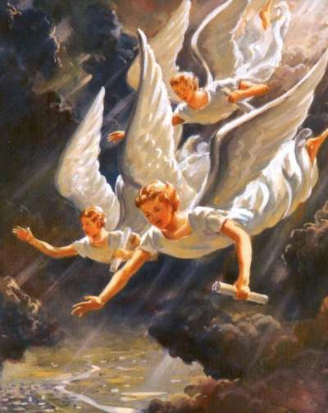
Call to worship
^{NIV} Revelation 14:7 He said in a loud voice, "Fear God and give him glory, because the hour of his judgment has come. Worship him who made the heavens, the earth, the sea and the springs of water."

Slide 3
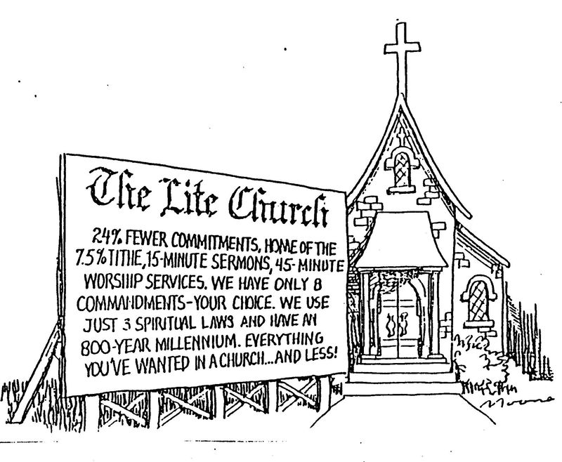

Slide 4
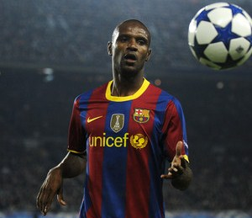
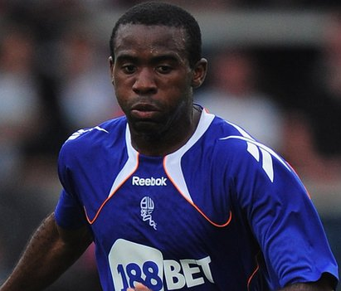
Prayer offered on the pitch

Slide 5
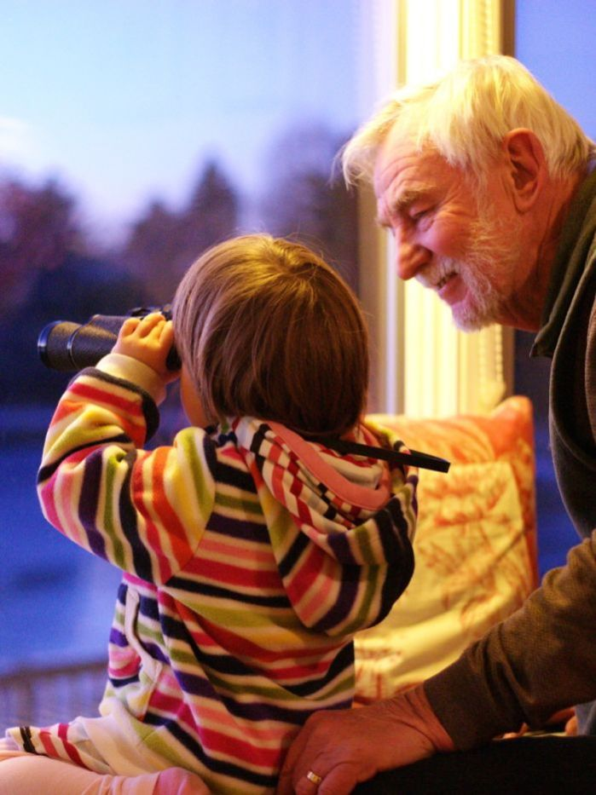
Worship as Response to the universal hunger
He has made everything beautiful in its time. He has also set eternity in the hearts of men; yet they cannot fathom what God has done from beginning to end. (Eccl 3:11 NIV)

Slide 6
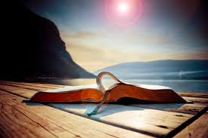
The human heart is the greatest idol factory
“Son of man, these men have set up idols in their hearts and put wicked stumbling blocks before their faces” (Ezek 14:3 NIV)

Slide 7
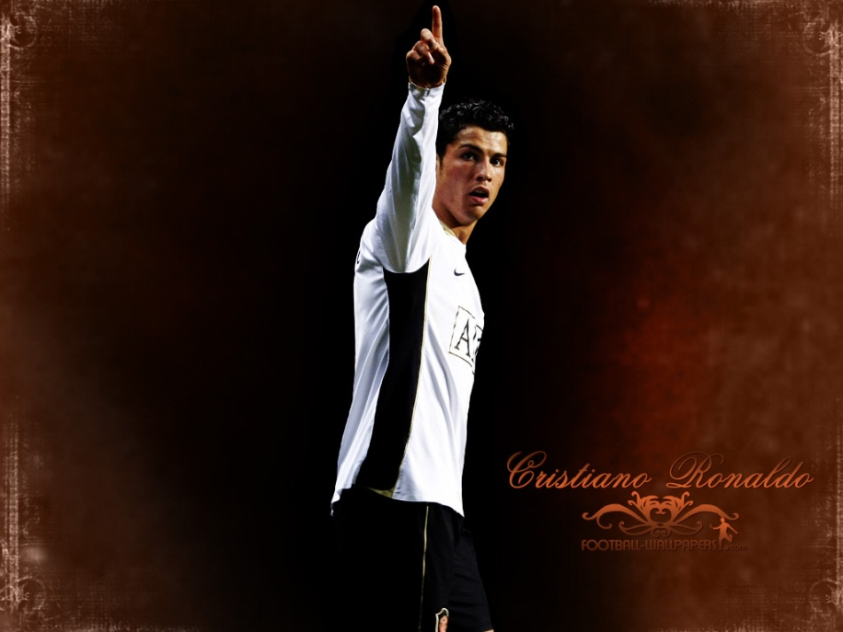
What is an idol, a false god?
anything that is more important to us than God
anything that occupies our hearts and our imagination more than God
anything which is expected to give us something that only God can give

Slide 8

How can we identify the idols in our lives?
What are we doing when we are alone?
What are we spending our money on? Jesus said: “For where your treasure is, there your heart will be also.” (Mat 6:21)
How do we relate to God, when He does not comply with what we asked Him for in prayer?
What lies behind our pain?

Slide 9
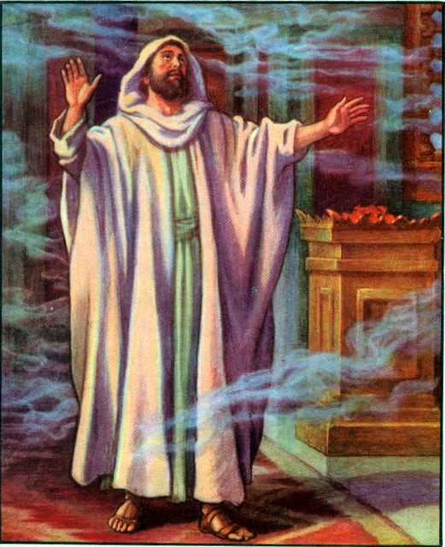
Isaiah 6 – the essence of worship I.
^{NIV} Isaiah 6:1-4 In the year that King Uzziah died, I saw the Lord seated on a throne, high and exalted, and the train of his robe filled the temple. ² Above him were seraphs, each with six wings: With two wings they covered their faces, with two they covered their feet, and with two they were flying. ³ And they were calling to one another: "Holy, holy, holy is the LORD Almighty; the whole earth is full of his glory." ⁴ At the sound of their voices the doorposts and thresholds shook and the temple was filled with smoke.
I. Seeing God and worship Him!

Slide 10
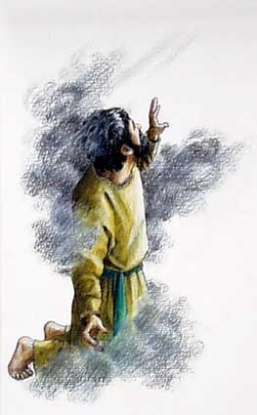
Isaiah 6 – the essence of worship II.
"Woe to me!" I cried. "I am ruined! For I am a man of unclean lips, and I live among a people of unclean lips, and my eyes have seen the King, the LORD Almighty." (Isa 6:5 NIV)
II. Seeing ourselves in the presence of God.

Slide 11
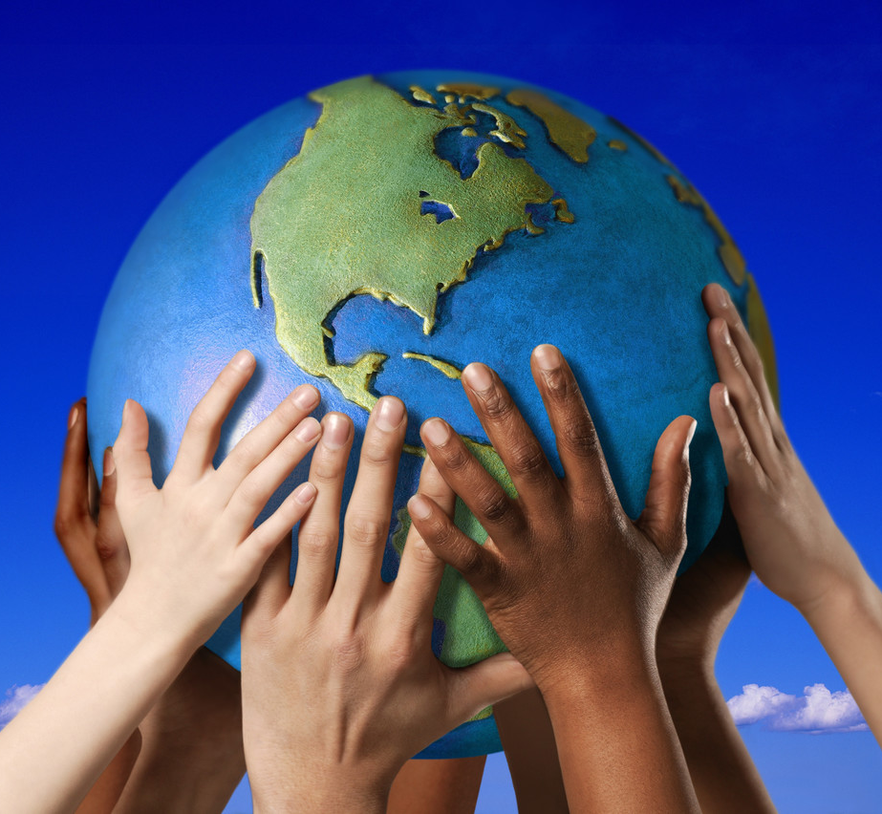
Priest in worship - Kingly priesthood
NIV 1 Peter 2:9 But you are a chosen people, a royal priesthood, a holy nation, a people belonging to God, that you may declare the praises of him who called you out of darkness into his wonderful light.

Slide 12
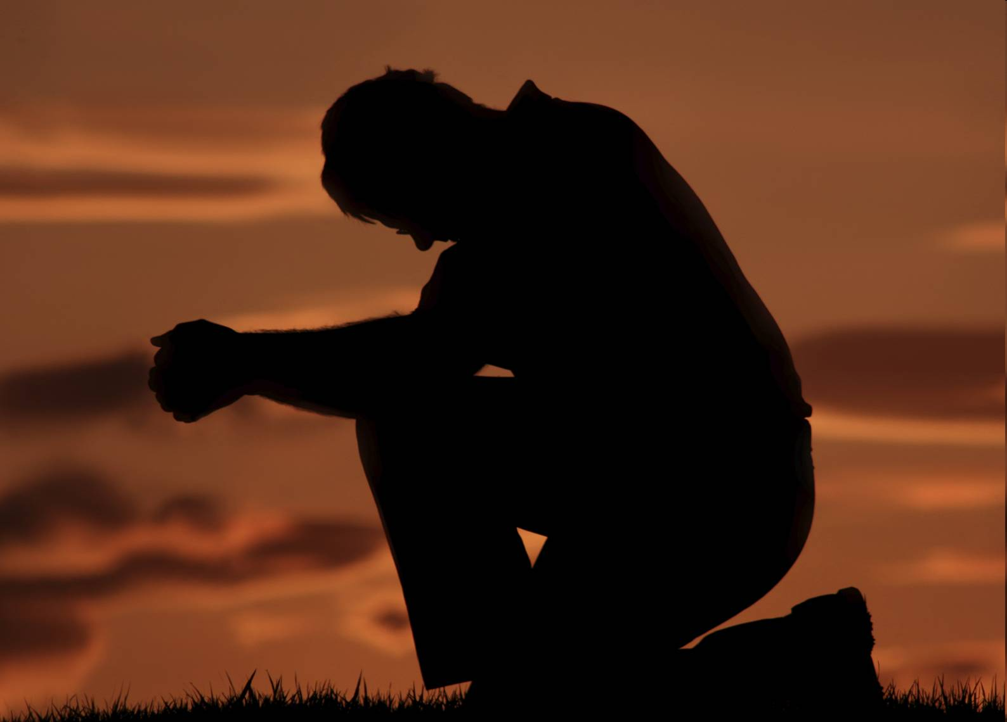
As priests we offer sacrifices
1. Daily sacrifice:
NIV Romans 12:1 Therefore, I urge you, brothers, in view of God's mercy, to offer your bodies as living sacrifices, holy and pleasing to God-- this is your spiritual act of worship.

Slide 13
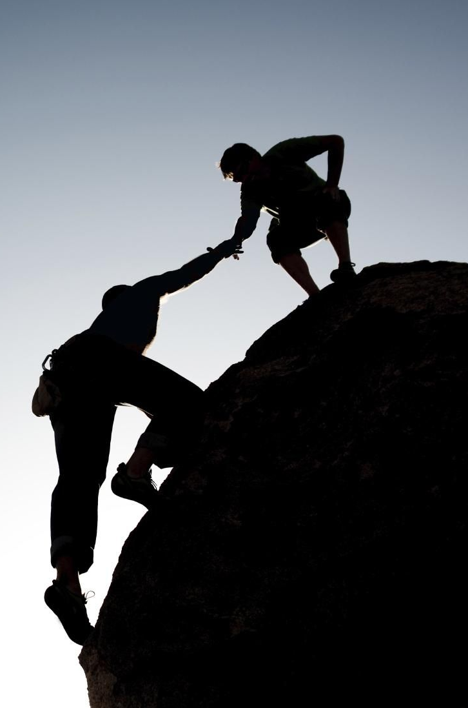
2. Witness and leading people to Christ
NIV Romans 15:16 to be a minister of Christ Jesus to the Gentiles with the priestly duty of proclaiming the gospel of God, so that the Gentiles might become an offering acceptable to God, sanctified by the Holy Spirit.
NIV Hebrews 13:15 Through Jesus, therefore, let us continually offer to God a sacrifice of praise-- the fruit of lips that confess his name.

Slide 14

3. Practical Christianity
NIV 1 Peter 2:5 you also, like living stones, are being built into a spiritual house to be a holy priesthood, offering spiritual sacrifices acceptable to God through Jesus Christ.
^{NIV} James 1:27 Religion (Worship) that God our Father accepts as pure and faultless is this: to look after orphans and widows in their distress and to keep oneself from being polluted by the world.
^{NIV} 1 Corinthians 10:31 So whether you eat or drink or whatever you do, do it all for the glory of God.

Slide 15
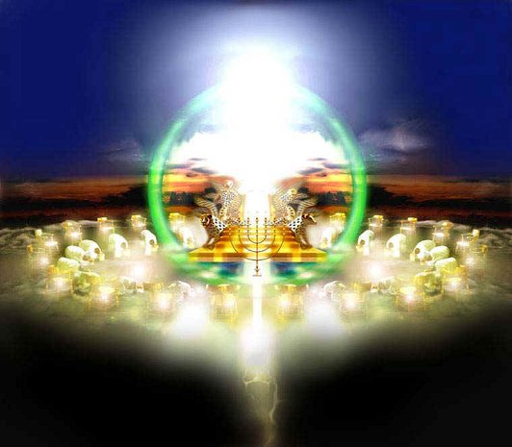
Heavenly Worship - Revelation
^{NIV} Revelation 4:8 Each of the four living creatures had six wings and was covered with eyes all around, even under his wings. Day and night they never stop saying: "Holy, holy, holy is the Lord God Almighty, who was, and is, and is to come."
^{NIV} Revelation 4:10.11. the twenty-four elders fall down before him who sits on the throne, and worship him who lives for ever and ever. They lay their crowns before the throne and say: "You are worthy, our Lord and God, to receive glory and honor and power, for you created all things, and by your will they were created and have their being.“
^{NIV} Revelation 5:8.9. And when he had taken it, the four living creatures and the twenty-four elders fell down before the Lamb. Each one had a harp and they were holding golden bowls full of incense, which are the prayers of the saints. And they sang a new song: "You are worthy to take the scroll and to open its seals, because you were slain, and with your blood you purchased men for God from every tribe and language and people and nation.

Slide 16
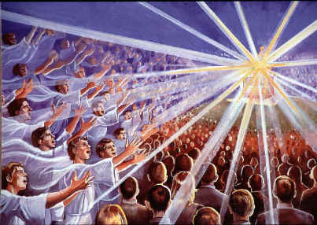
Heavenly Worship - Revelation
^{NIV} Revelation 5:11.12 Then I looked and heard the voice of many angels, numbering thousands upon thousands, and ten thousand times ten thousand. They encircled the throne and the living creatures and the elders. In a loud voice they sang: "Worthy is the Lamb, who was slain, to receive power and wealth and wisdom and strength and honor and glory and praise!“
^{NIV} Revelation 5:13 Then I heard every creature in heaven and on earth and under the earth and on the sea, and all that is in them, singing: "To him who sits on the throne and to the Lamb be praise and honor and glory and power, for ever and ever!"

Slide 17
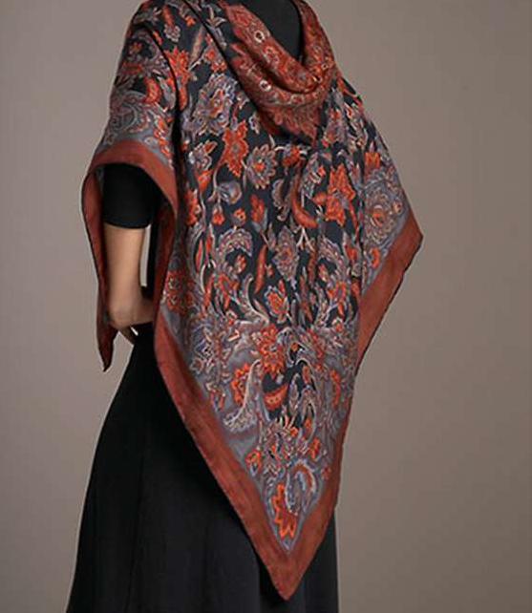
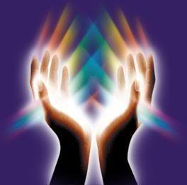

Slide 18
Sermon of edification
An Ancient story of Grace

Slide 19
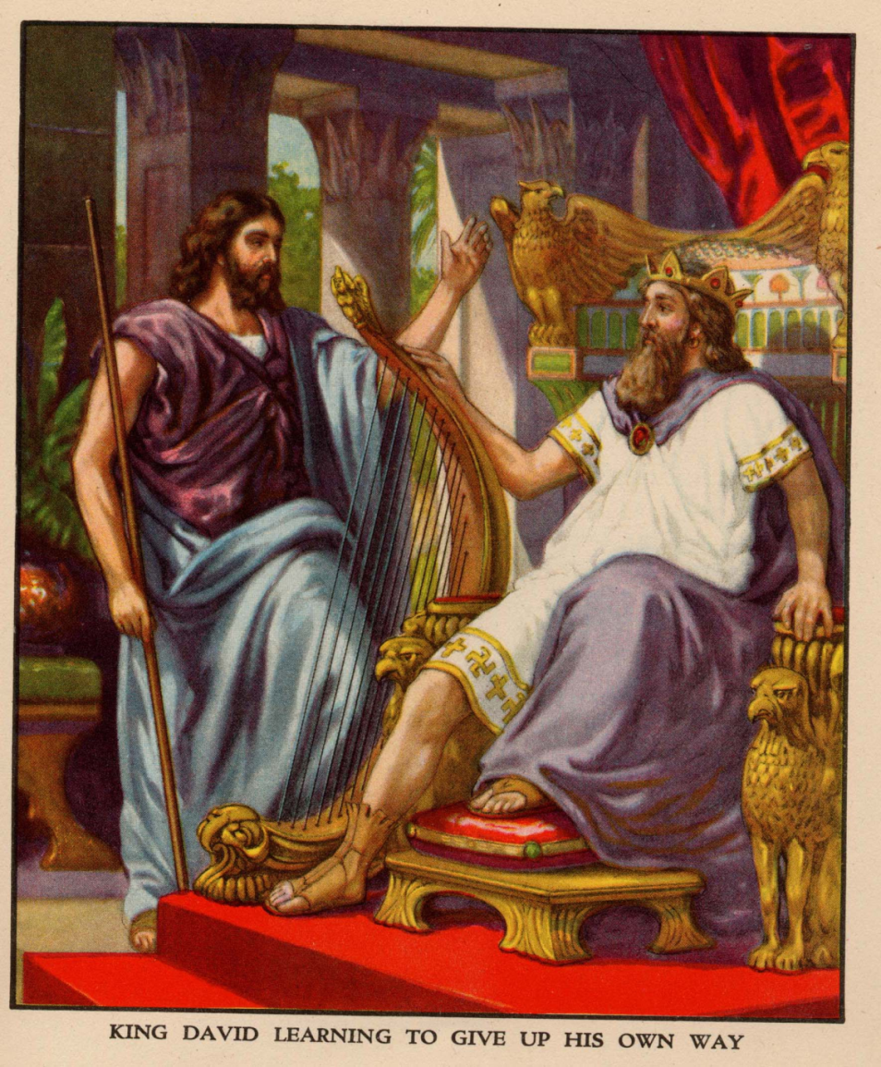
An Ancient story of GRACE

Slide 20

King David’s question:
^{NIV} 2 Samuel 9:1 “David asked, ‘Is there anyone still left of the house of Saul to whom I can show kindness for Jonathan's sake?’”

Slide 21
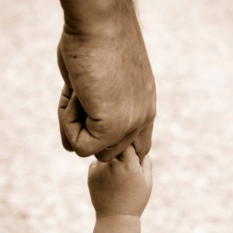
GRACE
Positive and unconditional acceptance of another person
Grace = showing love which is unmerited, undeserved and cannot be paid back.
Based on a promise: (between
Jonathan and David)
^{NIV} 1 Samuel 24:21 “Now
swear to me by the LORD that
you will not cut off my descendants or wipe out my name from my father's family.”

Slide 22
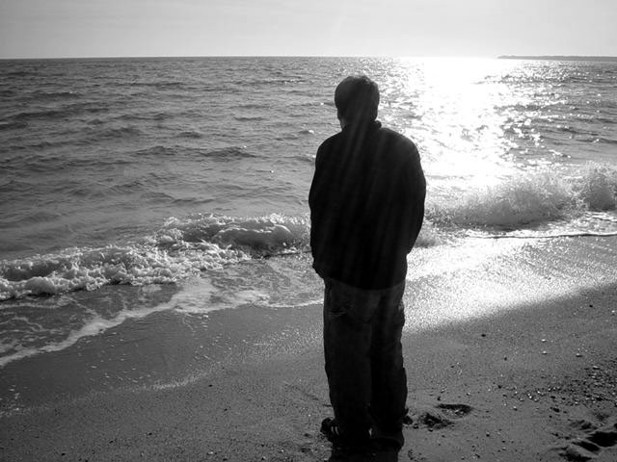
Is there “anyone”?
Not “somebody”!
NOT Somebody highly qualified
NOT Somebody who would be worthy for the GRACE of the King.
Simply: Anyone! Whoever!
^{NIV} John 3:16 “For God so
loved the world that he gave
his one and only Son, that whoever
believes in him shall not perish but have eternal life.”

Slide 23
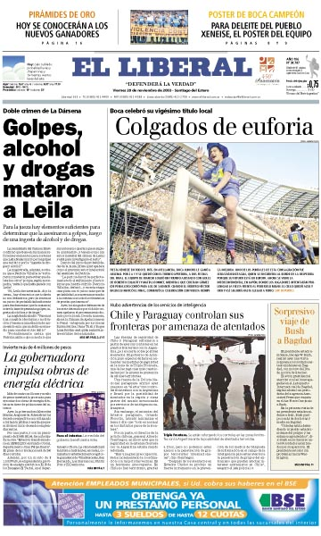
Communicate GRACE
Paco, Come home, please. Let us meet in the front of Montana Hotel in Madrid next Tuesday at noon! Everything is forgiven. Your Father

Slide 24
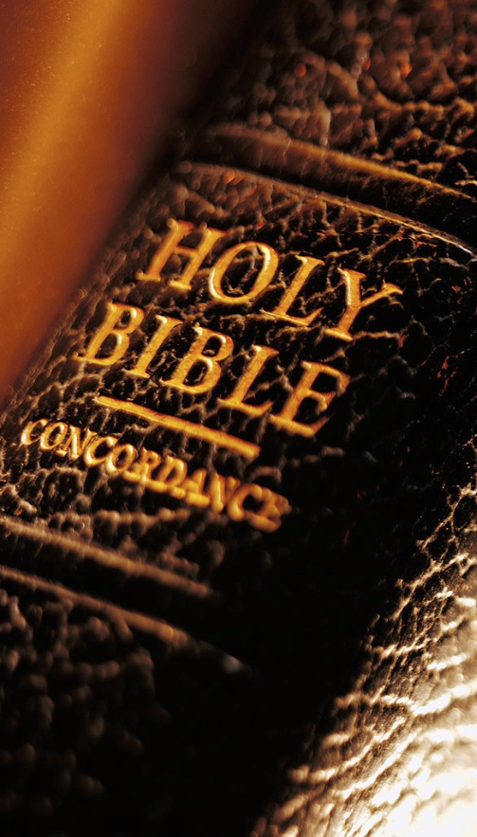
They found a “nobody”
^{NIV} 2 Samuel 9:2 “Now there was a servant of Saul's household named Ziba. They called him to appear before David, and the king said to him, ‘Are you Ziba?’ ‘Your servant,’ he replied.”
^{NIV} 2 Samuel 9:3 “The king asked, ‘Is there no one still left of the house of Saul to whom I can show God's kindness?’ Ziba answered the king, ‘There is still a son of Jonathan; he is crippled in both feet.’”

Slide 25

Background Info
^{NIV} 2 Samuel 4:4 “Jonathan son of Saul had a son who was lame in both feet. He was five years old when the news about Saul and Jonathan came from Jezreel. His nurse picked him up and fled, but as she hurried to leave, he fell and became crippled. His name was Mephibosheth.”

Slide 26

GRACE is always asking the right question
NOT “How badly is he crippled?” BUT
“Where is he?”
“He is in Lo Debar”
Lo = No. Debar = pasture
Lo Debar = Barren place, with no pasture.

Slide 27
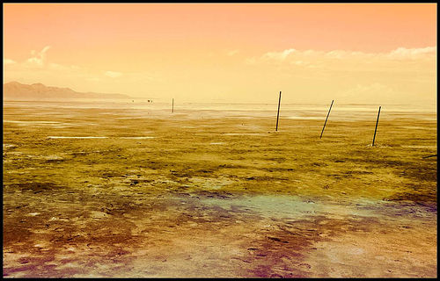
Barren place:

Slide 28
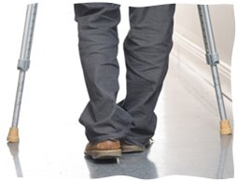
This “nobody” was loved...
By a wife
By a son
He was taken to
the king by soldiers
Farewell to his family…

Slide 29
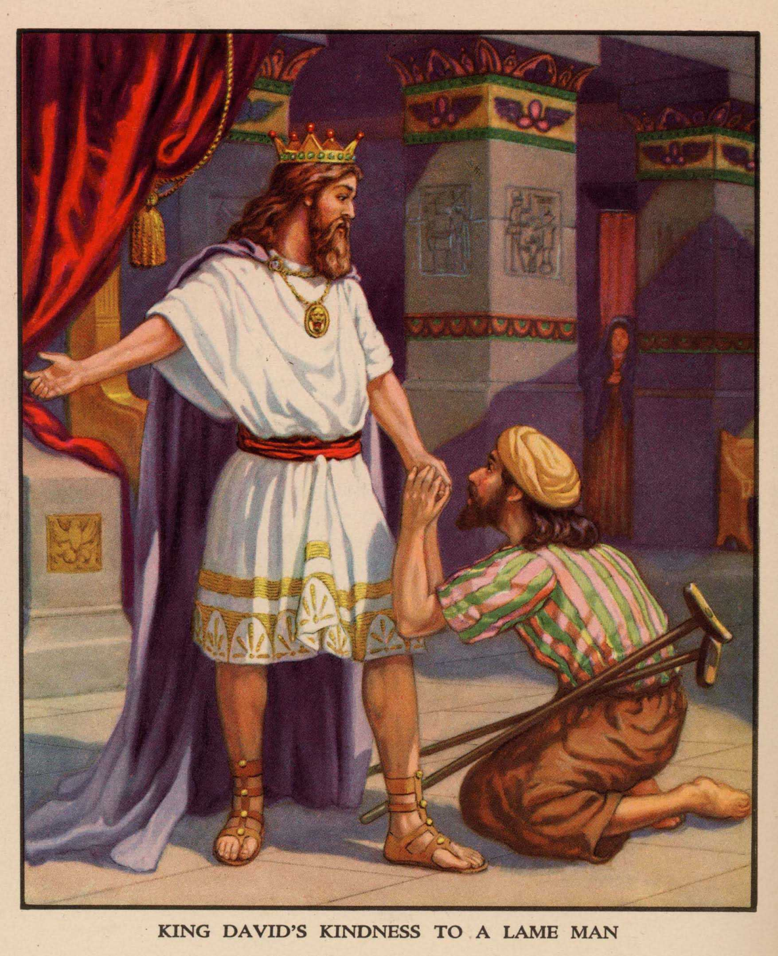

Slide 30

Meeting with the King
^{NIV} 2 Samuel 9:6 “When Mephibosheth son of Jonathan, the son of Saul, came to David, he bowed down to pay him honor. David said, ‘Mephibosheth!’ ‘Your servant,’ he replied.”

Slide 31
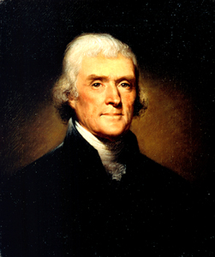
Thomas Jefferson

Slide 32
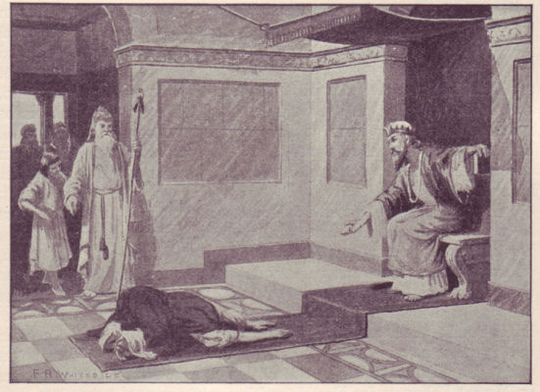
Grace released...

Slide 33
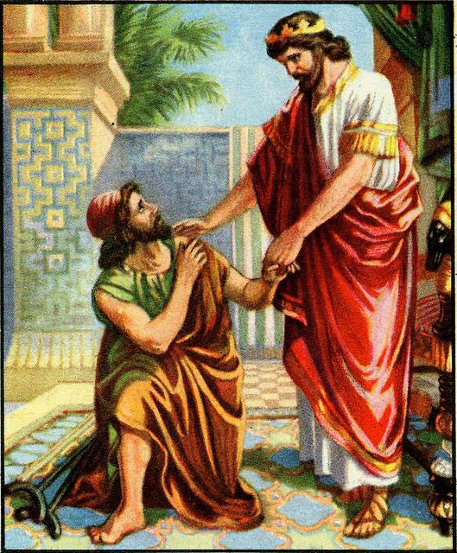
The “YES Face” of GRACE
NIV 2 Samuel 9:7 “‘Don't be
afraid,’ David said to him, ‘for I will surely show you kindness for the sake of your
father Jonathan. I will restore to
you all the land that belonged to your grandfather Saul, and you will always eat at my table.’”

Slide 34
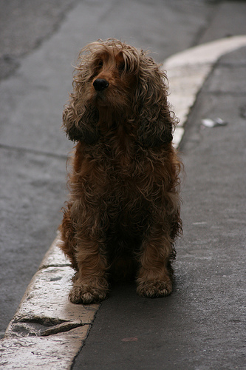
Grace unmerited...
^{NIV} 2 Samuel 9:8
“Mephibosheth bowed
down and said, ‘What is
your servant, that you
should notice a dead dog
like me?’”

Slide 35
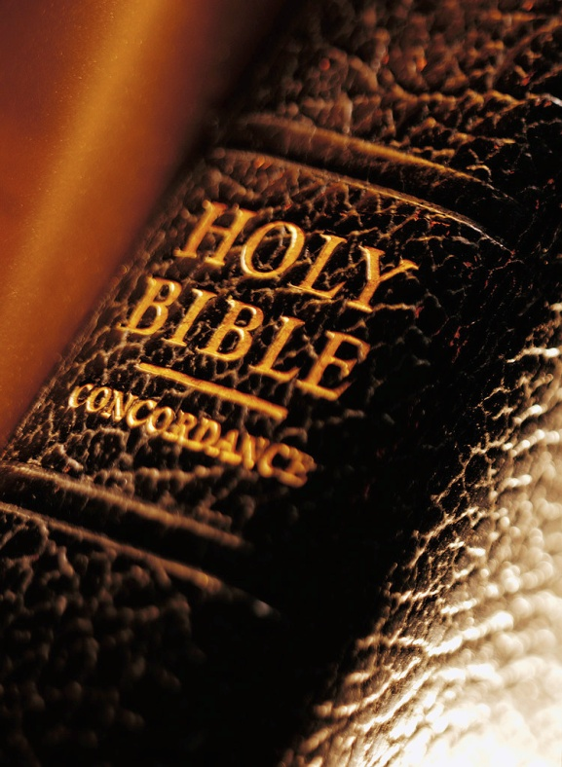
^{NIV} 2 Samuel 9:9 “Then the king summoned Ziba, Saul's servant, and said to him, ‘I have given your master's grandson everything that belonged to Saul and his family’”
^{NIV} 2 Samuel 9:10 “You and your sons and your servants are to farm the land for him and bring in the crops, so that your master's grandson may be provided for. And Mephibosheth, grandson of your master, will always eat at my table.”

Slide 36
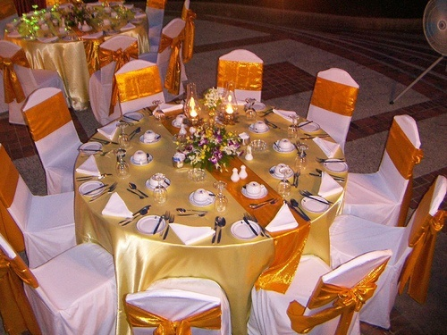
You are invited to the King’s table

Slide 37
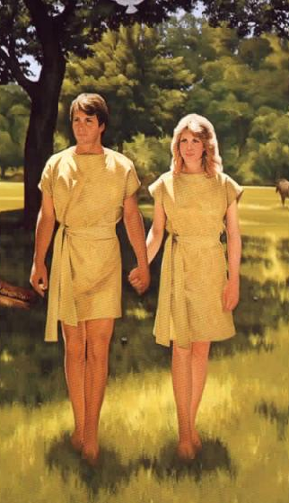
Lessons to learn:
For a while Mephibosheth was at the king’s table in his childhood.
Adam and Eve were living in the presence of God.

Slide 38
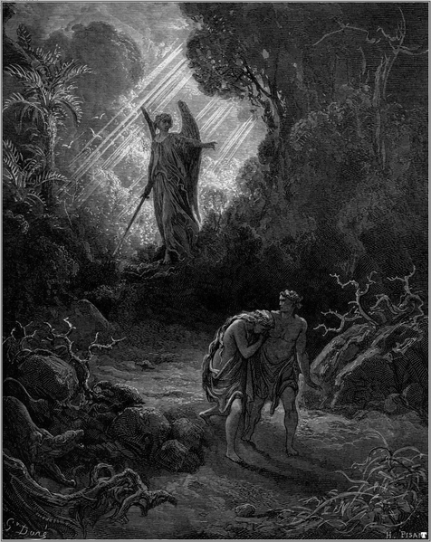
Lessons to learn:
When trouble came the nurse in her hurry fell on the child and made him crippled.
When sin came Adam and Eve were hiding from God – they became crippled spiritually.

Slide 39
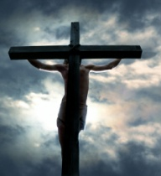
Lessons to learn:
David showed grace to Mephibosheth because of his relationship with Jonathan.
God showed us mercy because He loved us and gave His own Son as ransom for our sins.

Slide 40
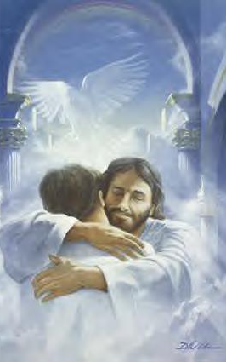
Lessons to learn:
Mephiboseth could not pay back anything to the king, he would not even try to gain his confidence.
Despite of all our sins God tells us: “You are Mine with your crutches as well!”

Slide 41
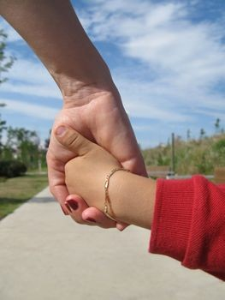
Lessons to learn:
David adopted Mephibosheth as his own son and invited him from the barren place to be part of the King’s family.
You are members of God’s Family.

Slide 42
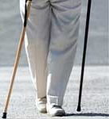
Lessons to learn:
Every single step made by Mephibosheth reminded him of the GRACE of the King.
Our small stumbling remind us of the GRACE of GOD.

Slide 43
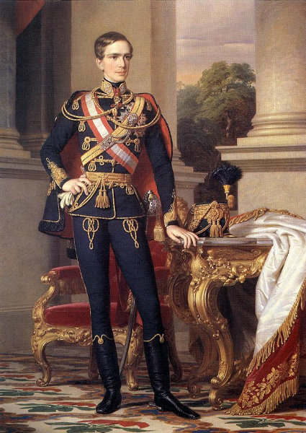
Franz Joseph

