Slide 1
Useful materials for sermon preparations

Slide 2

Ancient proverb
“He who knows and knows that he knows, is a master.
He who knows and does not know that he knows, needs a teacher.
He who does not know and knows that he does know, needs love.
He who does not know and knows that he does not know, is lost.”

Slide 3
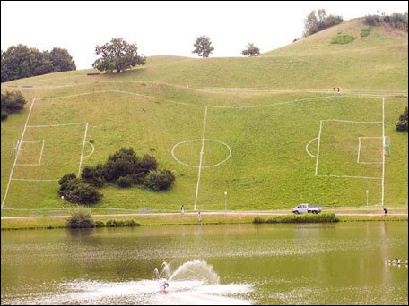
Do things right…

Slide 4

Who is a good preacher?
A good talker is not necessarily a good preacher
A poor talker is not necessarily a poor preacher
A good preacher is: who knows and loves Christ, knows and loves people and is willing to work hard to bring the two together

Slide 5
Biblical Preachers Spend Time with the Bible
Ellen White warns: "It is a sin to be neglectful the study of the Word while attempting to teach it to others" (Gospel Workers p.99).

Slide 6
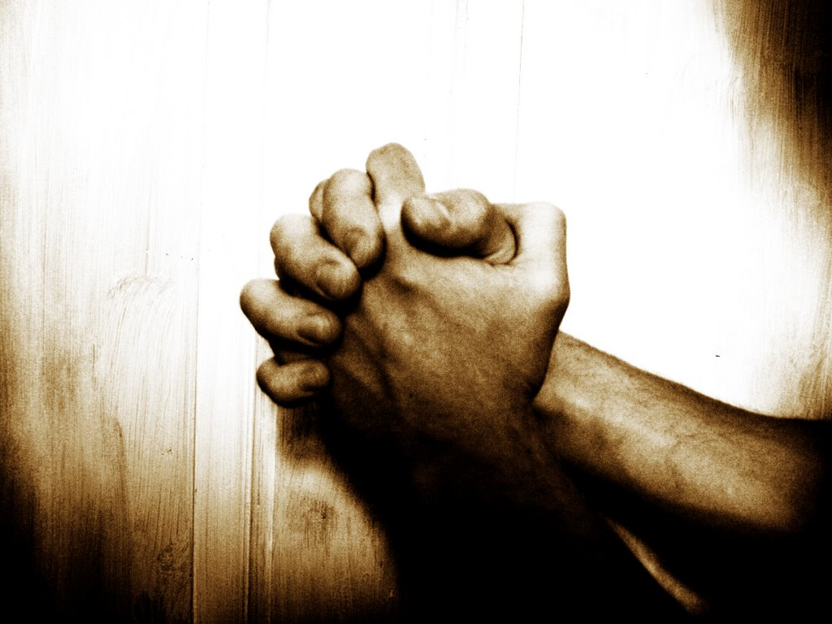
Biblical Preachers Apply the Bible to Themselves
They plead that God will speak to them before He speaks through them to others.
They approach the Bible story as participants not just spectators.

Slide 7
Know Your Tools
Bible Versions
Bible Reference Books
Ellen White Books
Know Your Preparation Takes Time.
The old rule of thumb is one hour in study for one minute in the pulpit.
Realistically, most preachers probably spend 10 to 20 hours preparing a 30 minute sermon.

Slide 8
The process of studying:
Be interested
Ask questions
Search for answers
Answer questions
Present the questions and answers in order to help others
Observe…

Slide 9

Reading
Read it for yourself
Let the Gospel touch your own life
Believe the Bible works
Spend time with your Bible
^{NIV} 2 Timothy 2:15 Do your best to present yourself to God as one approved, a workman who does not need to be ashamed and who correctly handles the word of truth.

Slide 10
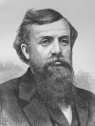
The Bible was not given to increase our knowledge but to change our lives.
-- D. L. Moody, Leadership, Vol. 9, no. 2.

Slide 11
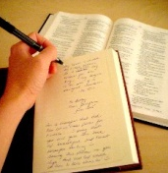
Journaling
As you study the Word write in your journal ideas and applications meaningful and exciting to you
The secret of interesting sermons: we interest others by that which exceedingly interests us
Journaling helps us focusing on the target

Slide 12

Use and involve your senses
Take one story from your Bible!
A. What do you see?
B. What do you hear?
C. What can you smell?
D. What taste can you feel?
E. What can you feel on your skin?
Put together the story!
Write a letter to Jesus in your Journal

Slide 13
Setting up your library
Shelf 1. Reference books:
  Dictionaries, concordances
  Bible versions
  Bible atlases
  Pastor’s manual
Shelf 2. Spirit of Prophecy books
Shelf 3-4. Old and New Testament books
Shelf 5. Doctrines
Shelf 6. Sermons and Sermon preparation
Shelf 7. Magazines
Shelf 8-12. Theology, Philosophy, Music, Counselling, Work of the Pastor

Slide 14

Use other resources
Newspapers/Radio/TV/Internet
Public Libraries
Theological Institutions
Research Institutions
Scholars and leaders of the Church
Be connected to the World

Slide 15

Pray, Study, Preach
Pray before you begin your study
Pray while you are studying
Pray while you are preaching
Powerful preaching is prayed down, not worked up
Bathe your study and preaching in prayer

Slide 16

Know your people and listeners
Study your people
Know their thoughts, desires, plans, problems
Get closer to them
Get lectures on Anthropology, Psychology

Slide 17
Illustrations...
Importance of Illustrations were emphasized in Jesus' preaching.
Illustrations help hold attention.
Illustrations motivate by adding emotion to your logic.
Illustrations help listeners retain truth longer.
Bible principles are the nail in the sermon, illustrations are the hummer

Slide 18
Purpose
a. Illustrations are not to clarify truth to the mind, but primarily to the heart: illustrate – is to primarily motivate, not to clarify
b. Explanation proves the truth
c. Illustrations are intended to root the truth in the life of a believer
  i. illustrating should primarily be for application versus explanation
  ii. ground listener in the mind, emotion, and will to experience what it would be like to see this truth in their lives.
  iii. It does not have to be contemporary, it could be historical
d. Life-situations reflect real problems and common emotions

Slide 19
How to use illustrations?
Be sure that the illustration illustrates.
Illustrations must be easily understood. Like a good joke, too much explanation indicates a lack of clarity or a lack of illustration.
Illustrations need to be credible. Make sure that you get the facts correct.
Personal illustrations help your audience identify, but the illustration should be modest, true, and discreet. Moreover, it’s wise to follow the advice of Howard Hendricks: “People will learn more from your struggles than your victories.”
Tell an illustration instead of reading it.
Do not use an illustration that has more impact than the big idea of the sermon.

Slide 20
Important!
The power of the sermon is never in the illustration. The power of the sermon is in the Word of God.

Slide 21
Use of illustrations
The sermon illustration is a story that may be used to help illuminate a Biblical truth.
dullness is no longer regarded as an indication of either a profound mind or a pious heart
The day has passed when people will scratch their heads and lift their hands in admiration over a sermon which is "so deep" that they cannot understand it.
It is no longer a crime to have a style that can be at once comprehended.

Slide 22
There is no place where clearness and simplicity are more absolutely imperative than in the pulpit.
the use of the sermon illustration helps the sermon to win.
The preacher is a messenger from God; he has good news to tell.
The messenger must appear in him.

Slide 23
The preacher is a story-teller
The man who can not tell a story well should go to school to learn from somebody who can teach him, if he wants to be a successful preacher.
There is a true sense in which the preacher's whole mission is to tell the story of Jesus.
To tell a story well you must appeal to the imagination.
You can never greatly stir men's hearts without this appeal to the imagination.

Slide 24
The power of stories
In their own time men like Liddon and Spurgeon and Farrar and Pearse and Simpson and Phillips Brooks and Beecher and Moody and Talmage have been the men who knew the power of talking in pictures. Great preachers of today know the power of the sermon illustration as well.
Sermons are weak which do not have a sermon illustration or two or three, to let the light into them and illuminate them.

Slide 25
Jesus
By using effectively and wisely illustrations and stories we are following the footsteps of our Master and attracting and holding the attention of the multitude by a skillful use of parables.

Slide 26
Effective Sermon Illustration
The One-Paragraph Story
Sentence #1: Provide a setting.
Sentence #2: Develop a problem/conflict.
Sentence #3: Lead to a climax. Make your people wonder what will happen.
Sentence #4: The resolution.
Sentence #5: Show the audience how the illustration exposes their fallen condition in a similar manner as your sermon text.
Sentence #6: Demonstrate how the Triune God saves the day in the gospel.

Slide 27
Some good advises
Get to the point and do not dwell on the story.
Use a variety of illustrations over time.
Keep the illustrations simple, with just the right level of detail.
Use illustrations sparingly.

Slide 28
Things are not always they seam to be...

Slide 29


Slide 30
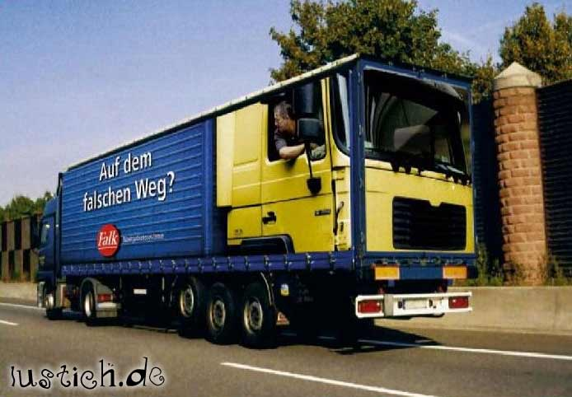

Slide 31
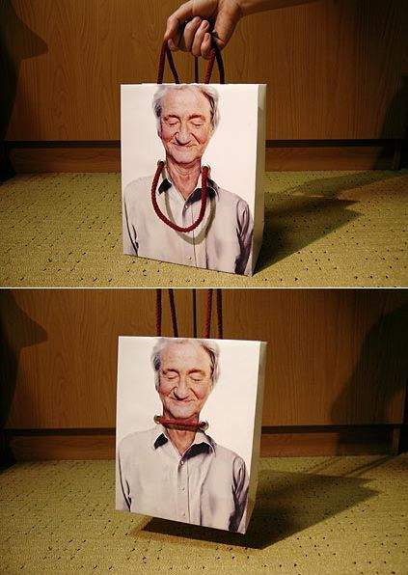

Slide 32


Slide 33


Slide 34
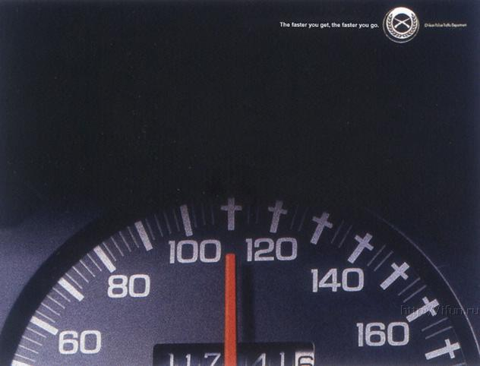

Slide 35


Slide 36
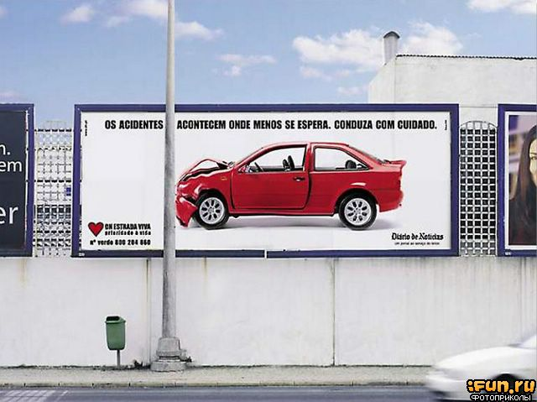

Slide 37
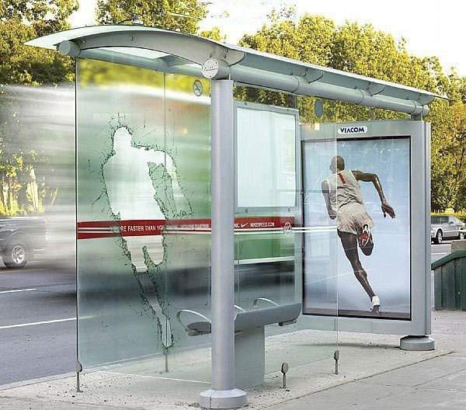

Slide 38


Slide 39


Slide 40


Slide 41


Slide 42
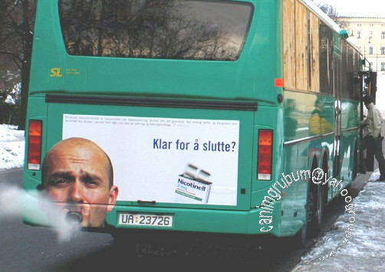
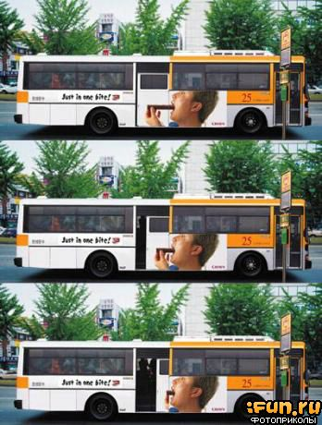
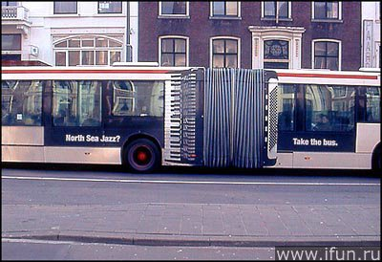

Slide 43


Slide 44
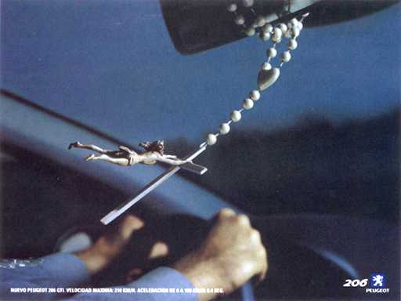

Slide 45
Suggested materials
www.sermoncentral.com
www.sermonillustrations.com
www.preachingtoday.com/find-sermon-illustrations
YouTube – Vintage Values – video sermon illustrations – especially parables of Jesus

