Slide 1

Creation

Slide 2
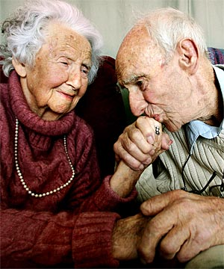
We tend to forget...

Slide 3
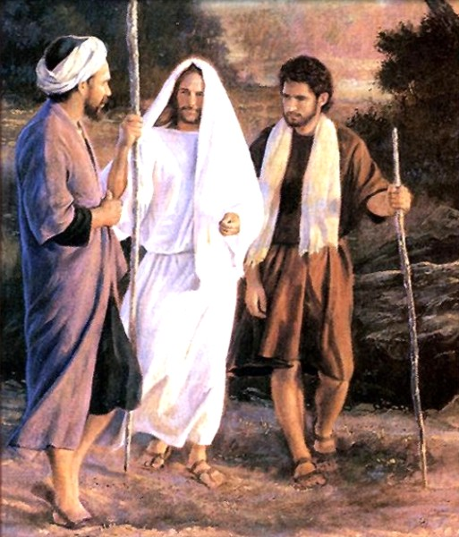
God’s story - Bible
^{NIV} Luke 24:27 And beginning with Moses and all the Prophets, he explained to them what was said in all the Scriptures concerning himself.

Slide 4
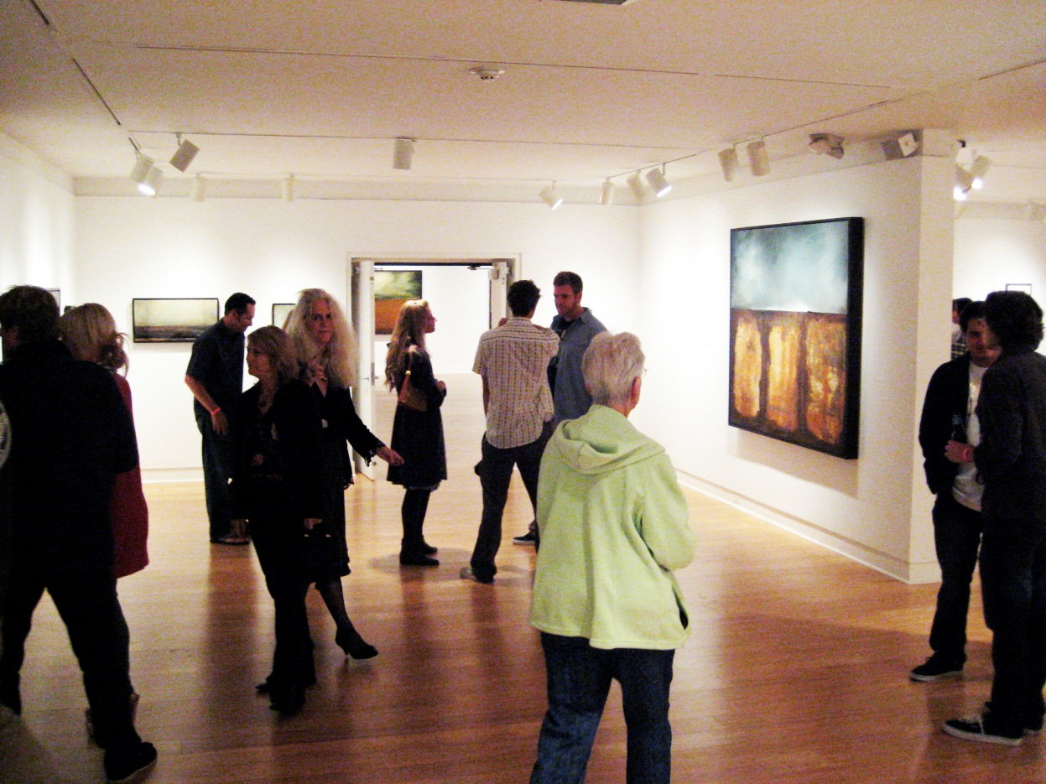
Meeting the artist?

Slide 5
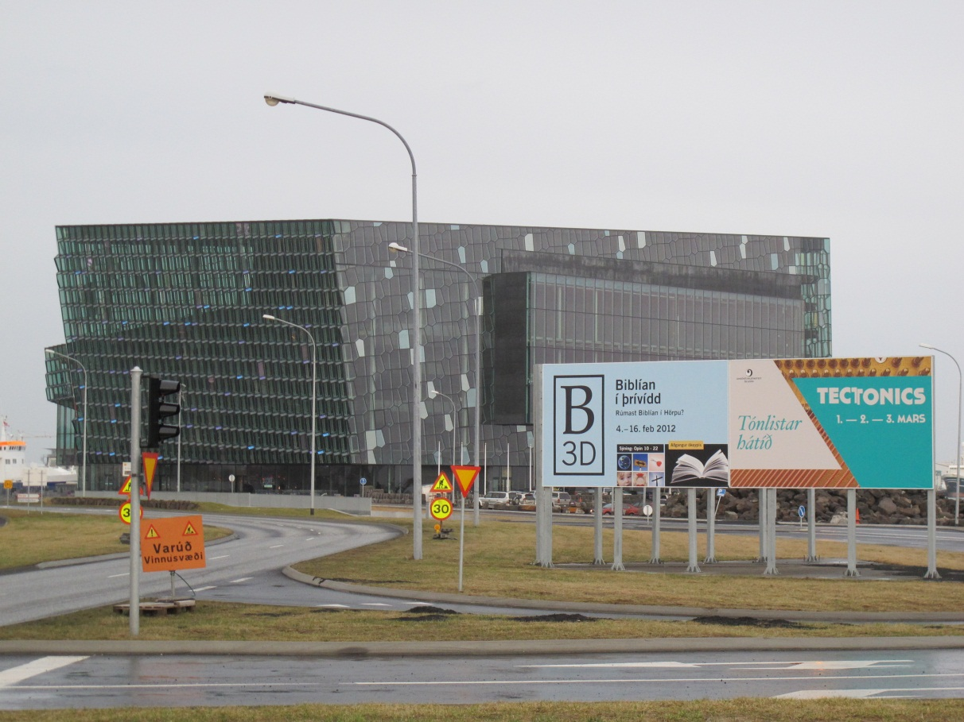
Walking through the “story”

Slide 6
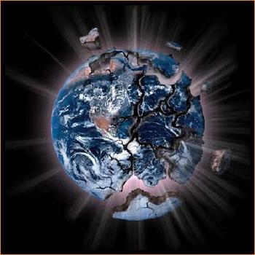
The question of existence
„We don’t see the world in its reality but we see it from the perspective of our reality.” /Talmud/
„Why is there `Something` rather than `nothing`/Richard Swinburne/

Slide 7
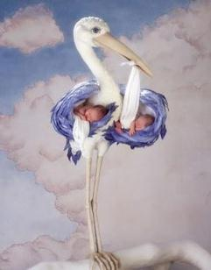
What do we teach our children?
"It’s no wonder that our young people today have poor self images when they go to school and read books that tell them that they are the products of blind chance that they are just accidents of nature unplanned, unloved, and unwanted.” /Frank Peretti/

Slide 8
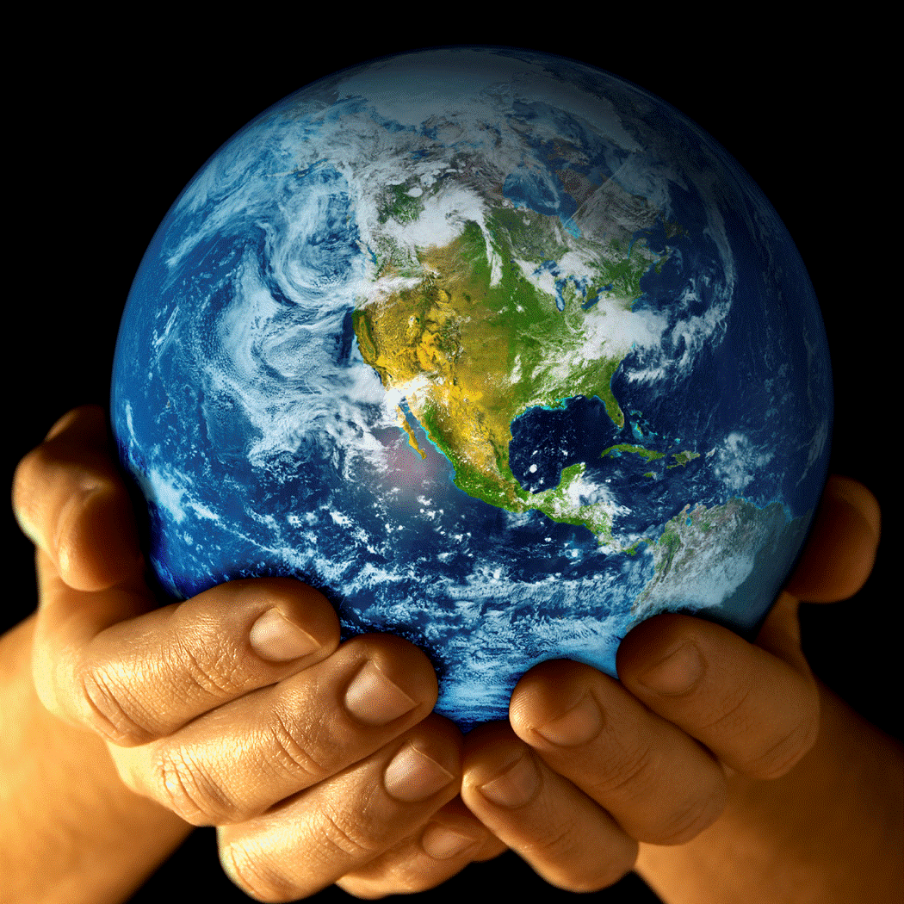
God the Creator - introduced
^{NIV} Genesis 1:1-3 In the beginning God created the heavens and the earth. ² Now the earth was formless and empty, darkness was over the surface of the deep, and the Spirit of God was hovering over the waters. ³ And God said, "Let there be light," and there was light.

Slide 9
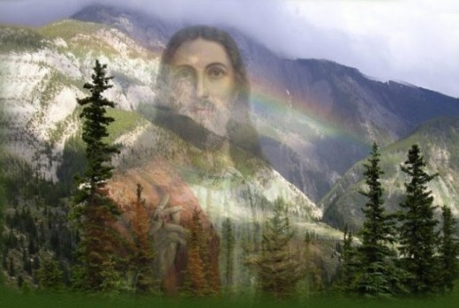
God creates in community
In the 1st verse the Father creates
In verse 2 the Holy Spirit hovers over the waters
In verse 3 God’ is creating through His Word

Slide 10
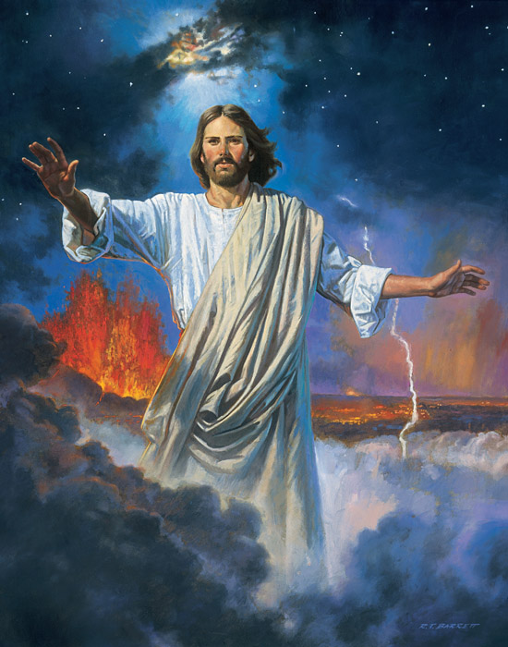
In the beginning...
^{NIV} John 1:1 In the beginning was the Word, and the Word was with God, and the Word was God.
^{NIV} John 1:14 The Word became flesh and made his dwelling among us. We have seen his glory, the glory of the One and Only, who came from the Father, full of grace and truth.

Slide 11
The outline of Creation
1st Day God separates Light from darkness | 2nd Day God separates The waters from the air | 3rd Day God separates The sea from land The land gives crops
4th Day God fills The light with the Sun; The darkness with the Moon and stars | 5th Day God fills The waters with fish, the air with birds | 6th Day God fills The land with animals and humankind The crops serve as food
7th Day God finished the work of separating and filling – creates community and sustains life. God creates a cathedral in time!

Slide 12
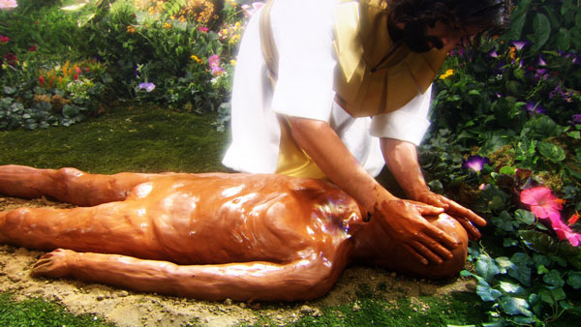
Human kind
^{NIV} Genesis 1:26 Then God said, "Let us make man in our image, in our likeness, and let them rule over the fish of the sea and the birds of the air, over the livestock, over all the earth, and over all the creatures that move along the ground."

Slide 13
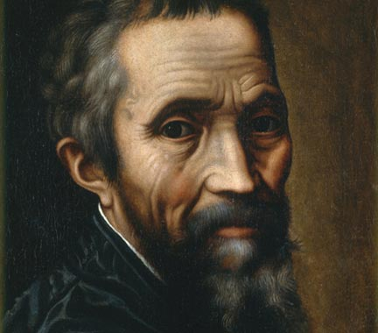
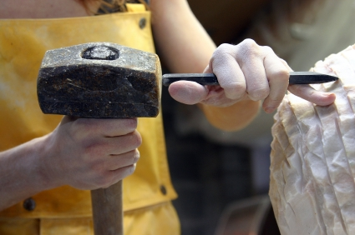
Continue, please!...

Slide 14
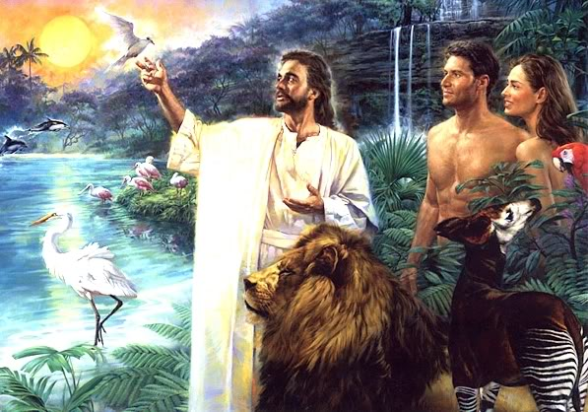
On His image and likeness…
On God’s image means that we are capable of communicating with God
We are created for vertical and horizontal relationships

Slide 15
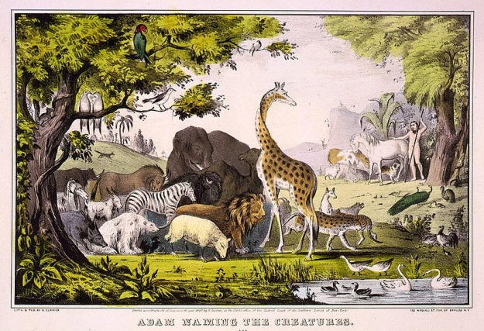
We are capable of horizontal relationships, too
^{NIV} Genesis 2:18 The LORD God said, "It is not good for the man to be alone. I will make a helper suitable for him." ¹⁹ Now the LORD God had formed out of the ground all the beasts of the field and all the birds of the air. He brought them to the man to see what he would name them; and whatever the man called each living creature, that was its name. ²⁰ So the man gave names to all the livestock, the birds of the air and all the beasts of the field. But for Adam no suitable helper was found.

Slide 16
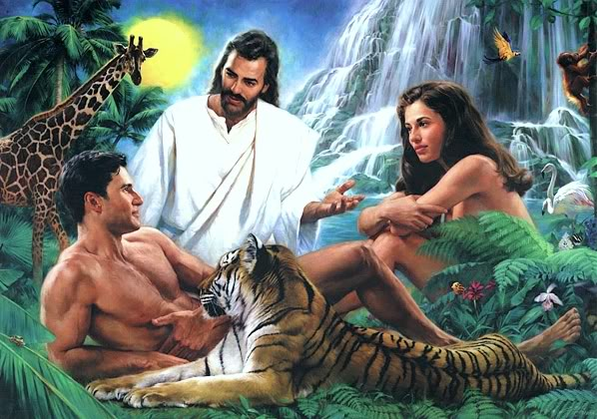
Couple…
^{NIV} Genesis 2:22 Then the LORD God made a woman from the rib he had taken out of the man, and he brought her to the man.

Slide 17
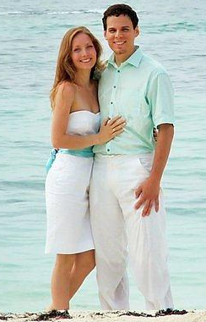
Compliment each other
^{NIV} Genesis 2:23 The man said, "This is now bone of my bones and flesh of my flesh; she shall be called 'woman, ' for she was taken out of man."

Slide 18
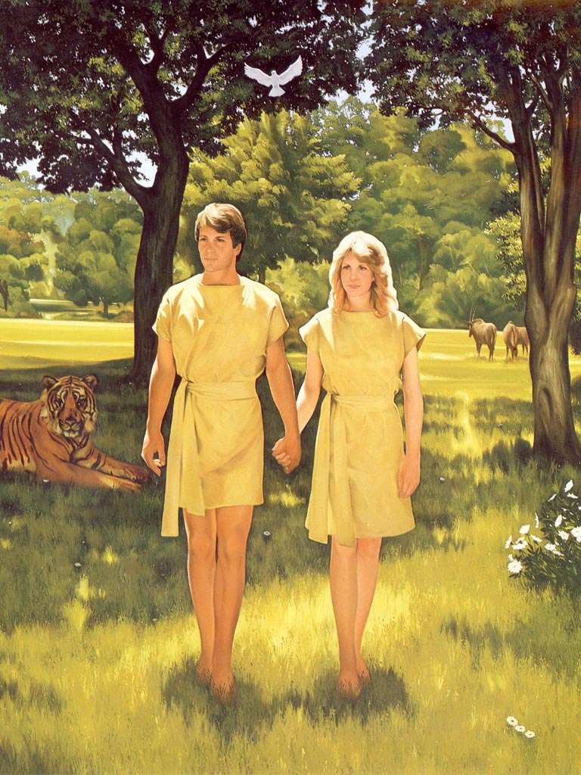
Duty and blessing
^{NIV} Genesis 1:28 God blessed them and said to them, "Be fruitful and increase in number; fill the earth and subdue it. Rule over the fish of the sea and the birds of the air and over every living creature that moves on the ground."

Slide 19
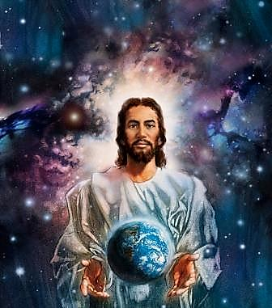
We are God’ creation
^{NIV} Ephesians 2:10 For we are God's workmanship, created in Christ Jesus to do good works, which God prepared in advance for us to do.
With fewer and fewer human rights...

Slide 20
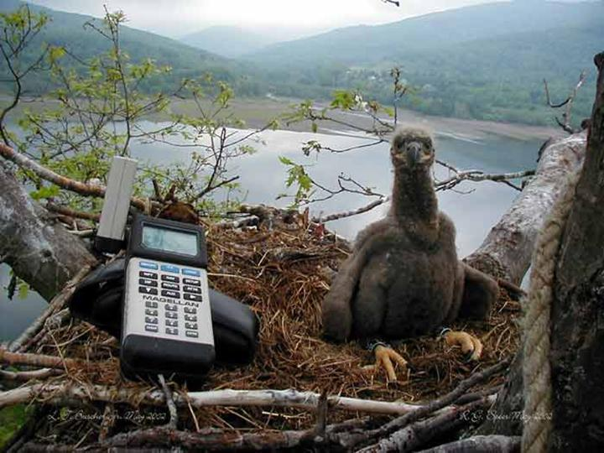
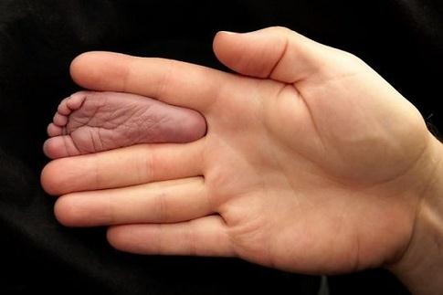
Rights?...

Slide 21

Scientific approach
„It is obvious that twice as much workers execute the gas installation work twice as faster, however if one woman produces a baby in nine months this does not mean that nine women would produce a baby in one month.”/Szent-Györgyi Albert/

Slide 22
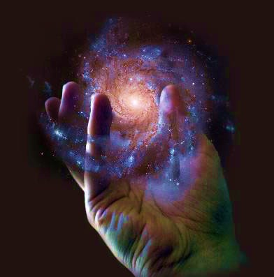
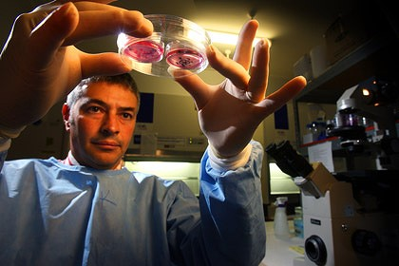
Scientists and God...

Slide 23
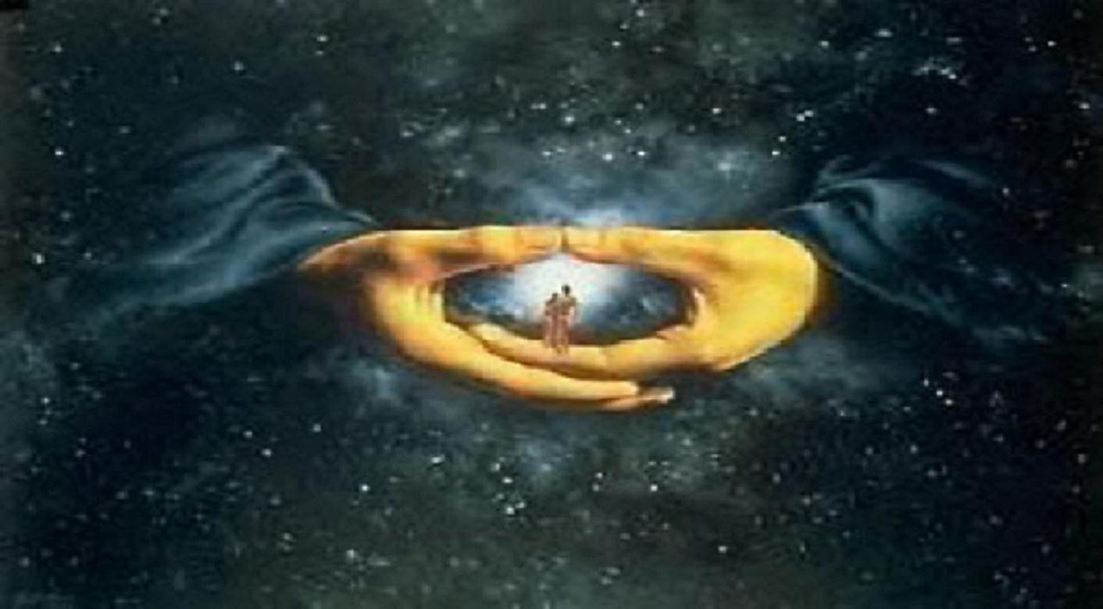
Mankind – God’s masterpiece
^{NIV} Psalm 139:14 I praise you because I am fearfully and wonderfully made; your works are wonderful, I know that full well.

Slide 24
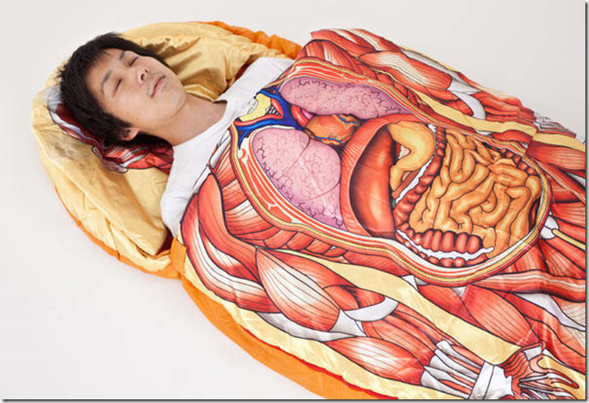
Masterpiece
We eat 1,5 kg food a day
We transpire 8 dl
We drink 1,4 l a day
We turn 25-30 times a night
We move 750 important muscles a day
We are breading 23.040 times
We speak 25.000-30.000 words
Our hear beats 103.689 times
We use 7 Million brain cells Our blood circulates 270 Million kms

Slide 25
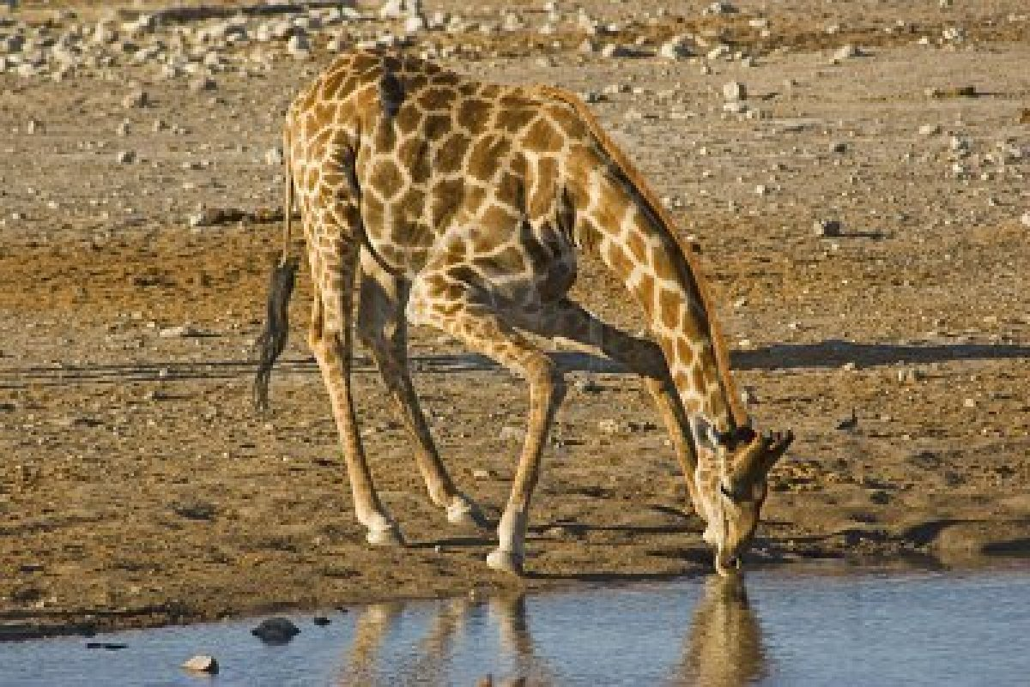
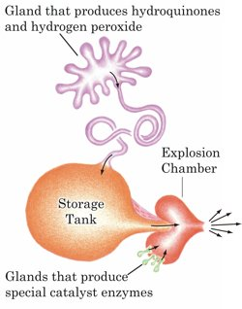
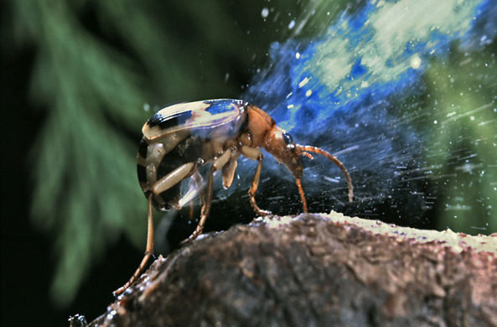
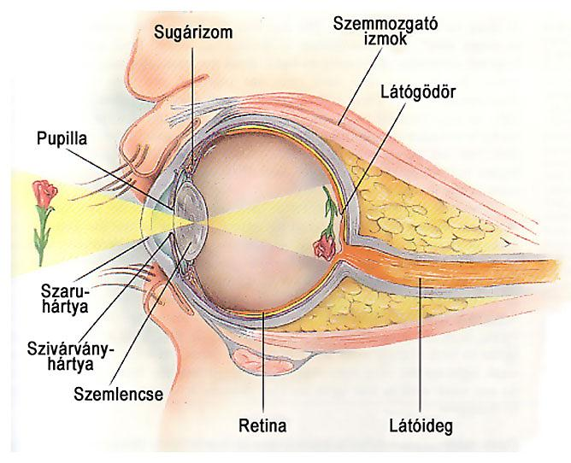
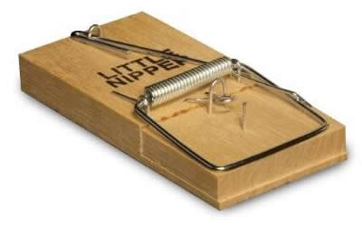
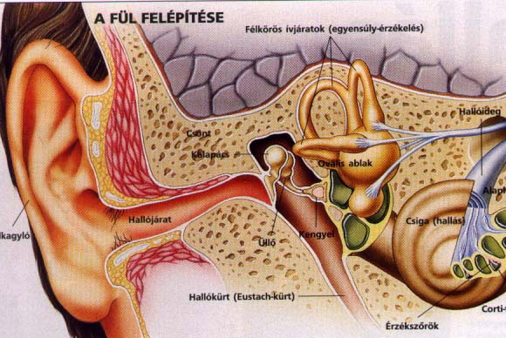
“irreducible complexity”

Slide 26
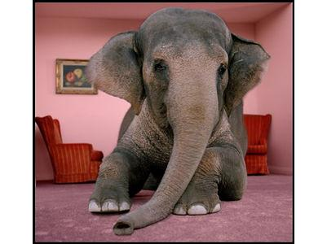
Michael J. Behe

Slide 27
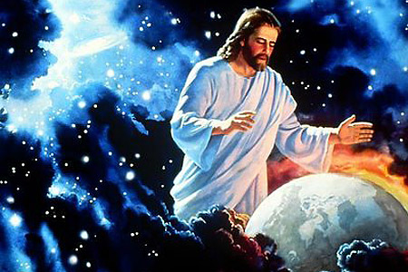
Meaningful beginning
^{NIV} Psalm 33:9 For he spoke, and it came to be; he commanded, and it stood firm.

Slide 28
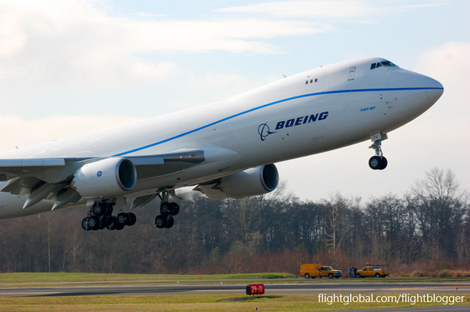
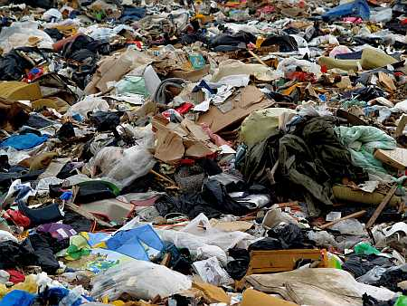
The chance of life by chance…
"The chance that higher life forms might have emerged in this way (time and chance) is comparable with the chance that 'a tornado sweeping through a junk-yard might assemble a Boeing 747 from the materials therein.”
/Sir Fred Hoyle/

Slide 29
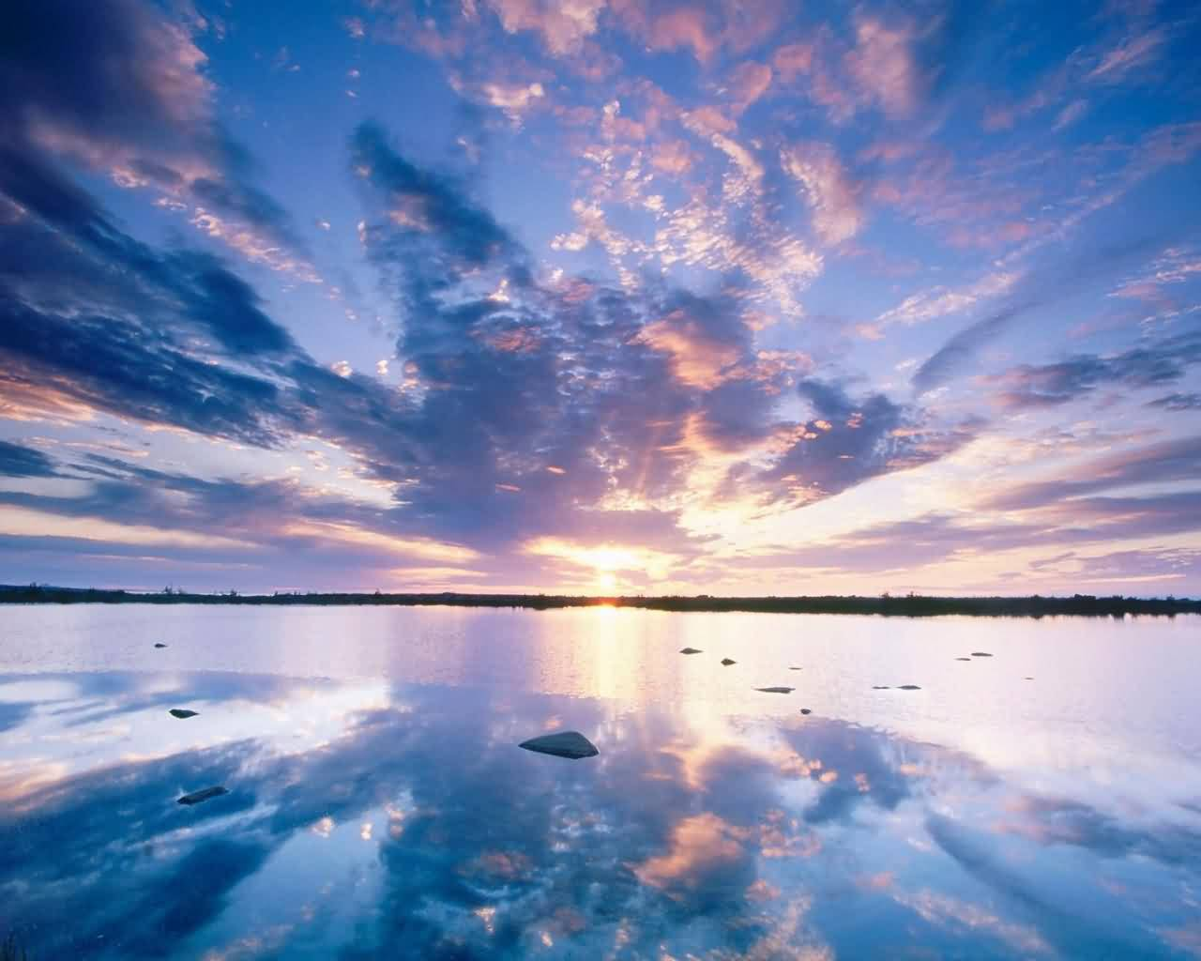
Nature’s “Bible”
^{NIV} Romans 1:20 For since the creation of the world God's invisible qualities--his eternal power and divine nature--have been clearly seen, being understood from what has been made, so that men are without excuse.

Slide 30
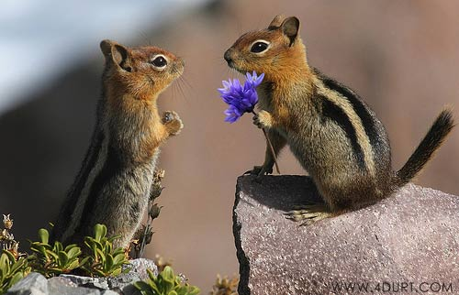
Even animals “talk”…
^{NIV} Job 12:7 "But ask the animals, and they will teach you, or the birds of the air, and they will tell you; ⁸ or speak to the earth, and it will teach you, or let the fish of the sea inform you. ⁹ Which of all these does not know that the hand of the LORD has done this? ¹⁰ In his hand is the life of every creature and the breath of all mankind.

Slide 31
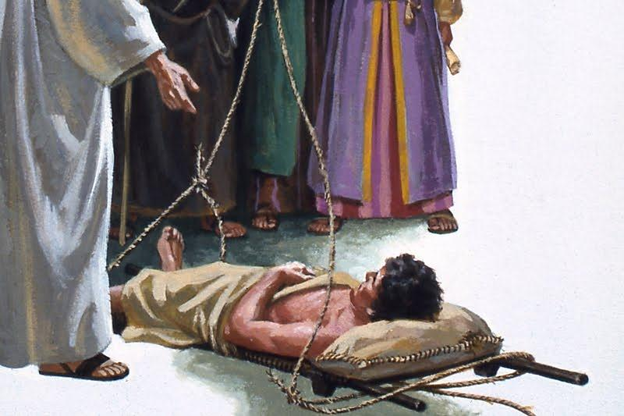
Somebody Who cares…
^{NIV} Matthew 9:2 …he said to the paralytic, "Take heart, son; your sins are forgiven."

Slide 32
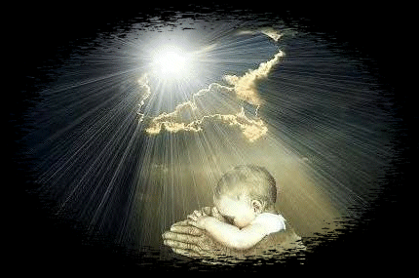
He knows us
^{NIV} Psalm 139:1 For the director of music. Of David. A psalm. O LORD, you have searched me and you know me. ² You know when I sit and when I rise; you perceive my thoughts from afar. ³ You discern my going out and my lying down; you are familiar with all my ways. ⁴ Before a word is on my tongue you know it completely, O LORD. ⁵ You hem me in--behind and before; you have laid your hand upon me. ⁶ Such knowledge is too wonderful for me, too lofty for me to attain.

Slide 33
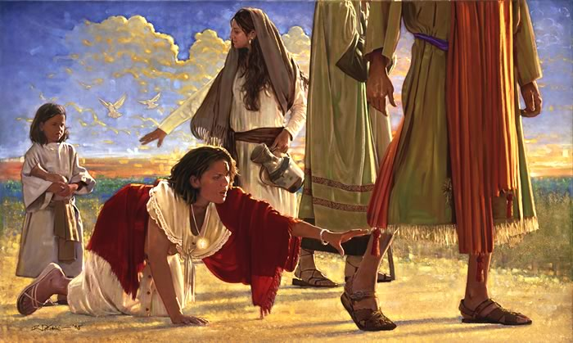
We are not left alone
^{NIV} Luke 8:48 Then he said to her, "Daughter, your faith has healed you. Go in peace."

Slide 34
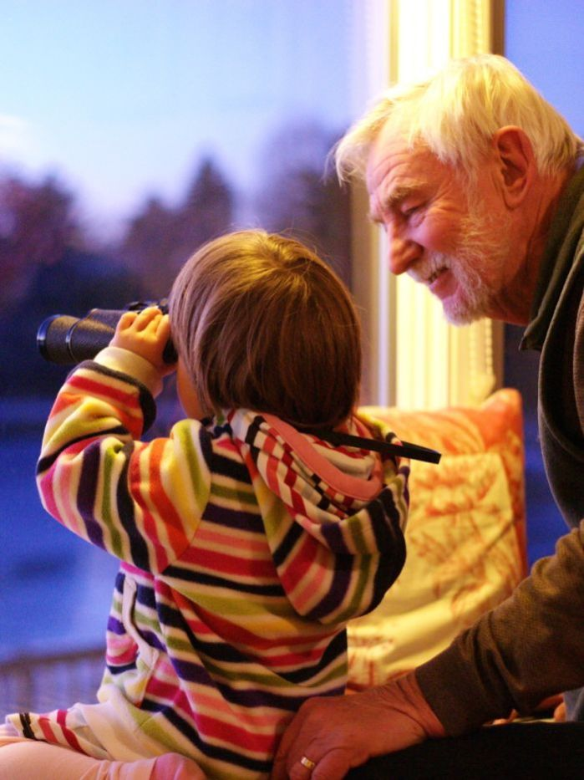
He planted eternity in us
^{NIV} Ecclesiastes 3:11 He has made everything beautiful in its time. He has also set eternity in the hearts of men; yet they cannot fathom what God has done from beginning to end.

Slide 35
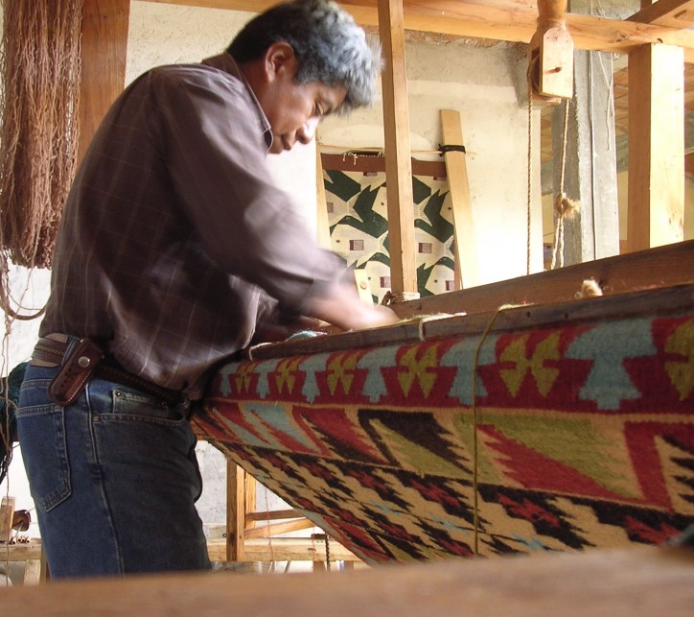
Do we see it’s colour?
The world is God-woven carpet,
We can only see its reverse side here,
And sometimes, in our most beautiful times,
we see the colourful side, too.
/Reményik Sándor: The other side of the carpet/

Slide 37
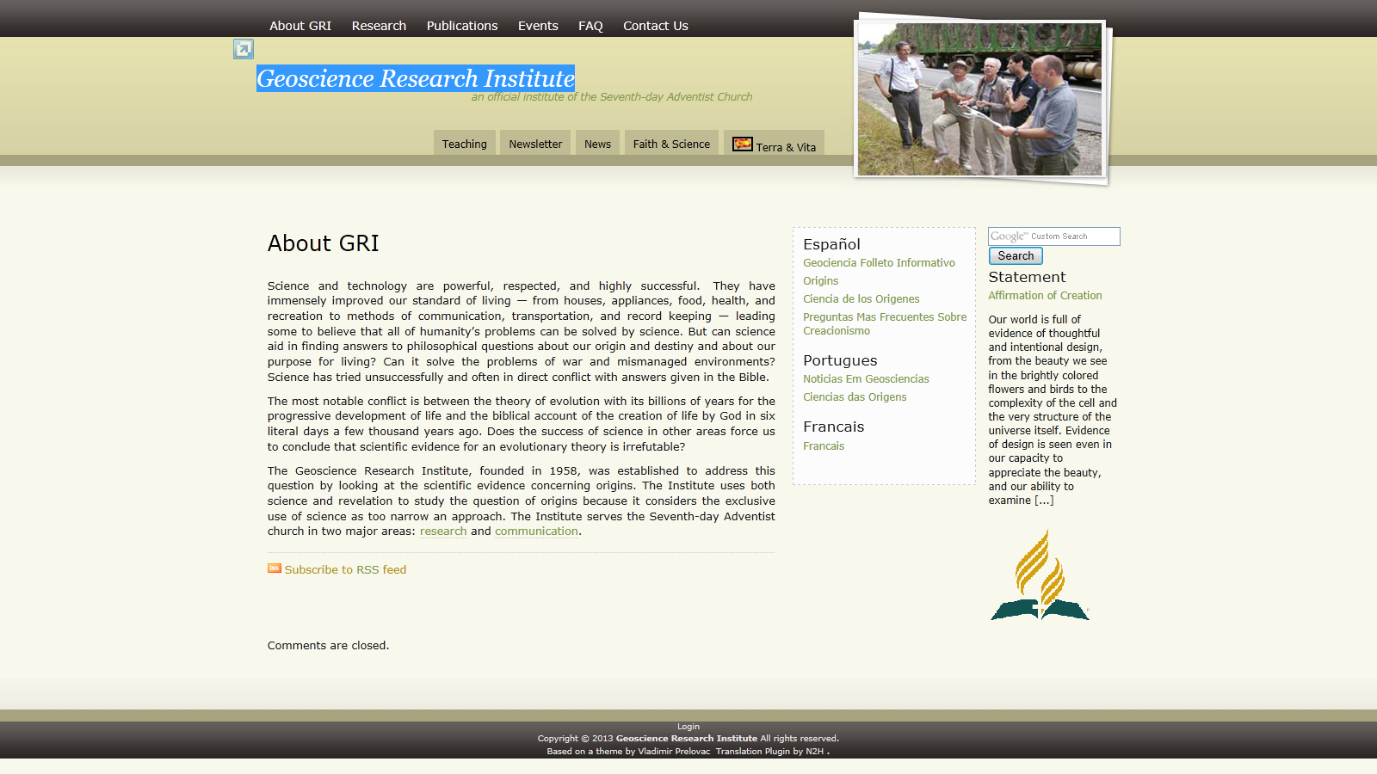
Resources
http://www.grisda.org - Geoscience Research Institute

Slide 38
