Slide 1
Preaching on the Second Coming of Jesus
1. “Waiting with confidence” – relational
2. “The end of the world”- sign-based
Preaching Seminar
Norway, 2012

Slide 2
Summary
1. Introduction – waiting
2. Trust Jesus’ presence
3. His Word is as good as His presence
4. Trust Jesus’ actions – journey and wedding
5. Trust Jesus’ promises – there is room…
6. Waiting with confidence – the farmer

Slide 3


Waiting...

Slide 4

The message of the Bible
Old Testament from Genesis through Malachi (39 books) could be summed up as saying, "Jesus is coming."
Matthew, Mark, Luke and John proclaim, "Jesus is here.“
The remaining 23 books of the New Testament tell us, "Jesus is coming again!" and we need to get prepared to meet Him

Slide 5
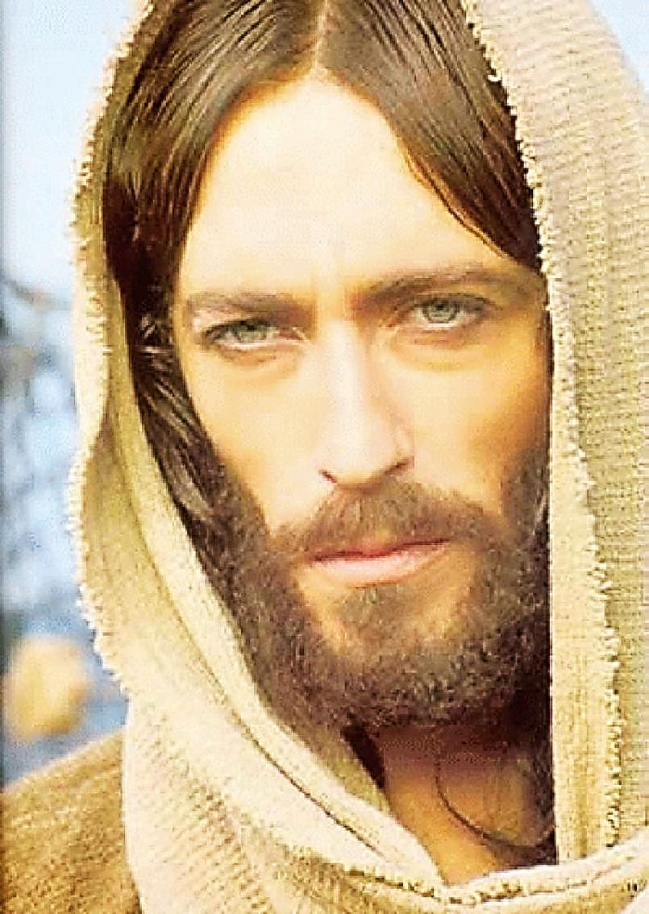
Wait with confidence
"Do not let your hearts be troubled. Trust in God; trust also in me. In my Father's house are many rooms; if it were not so, I would have told you. I am going there to prepare a place for you. And if I go and prepare a place for you, I will come back and take you to be with me that you also may be where I am. You know the way to the place where I am going." Thomas said to him, "Lord, we don't know where you are going, so how can we know the way?" Jesus answered, "I am the way and the truth and the life. No one comes to the Father except through me.” (John 14:1-6)

Slide 6
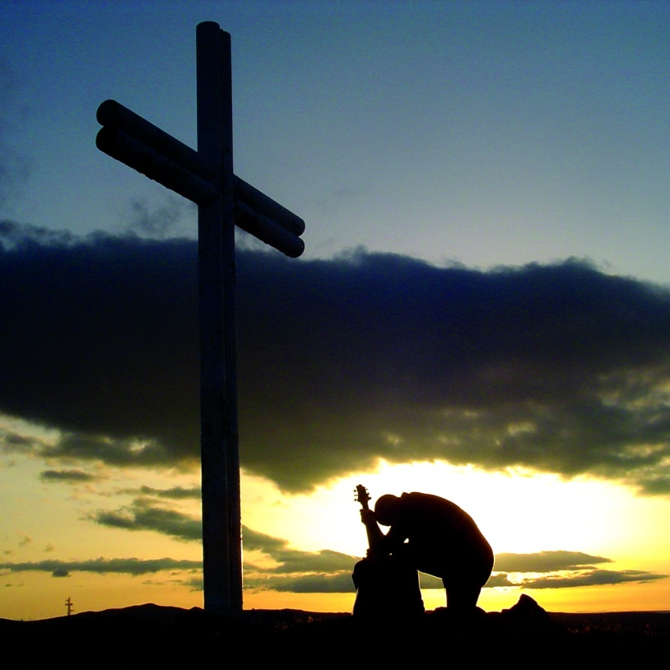
Trust in my presence!
"Do not let your hearts be troubled. Trust in God; trust also in me.” (John 14:1)
“Trust is Basic dependence on someone or something, Belief that something will happen or someone will act is a prescribed way.” (Webster Dictionary)

Slide 7

Jesus
"I know you trust in God, and you also trust in Me. Now remember, when you can no longer see Me, don’t stop trusting in Me."

Slide 8
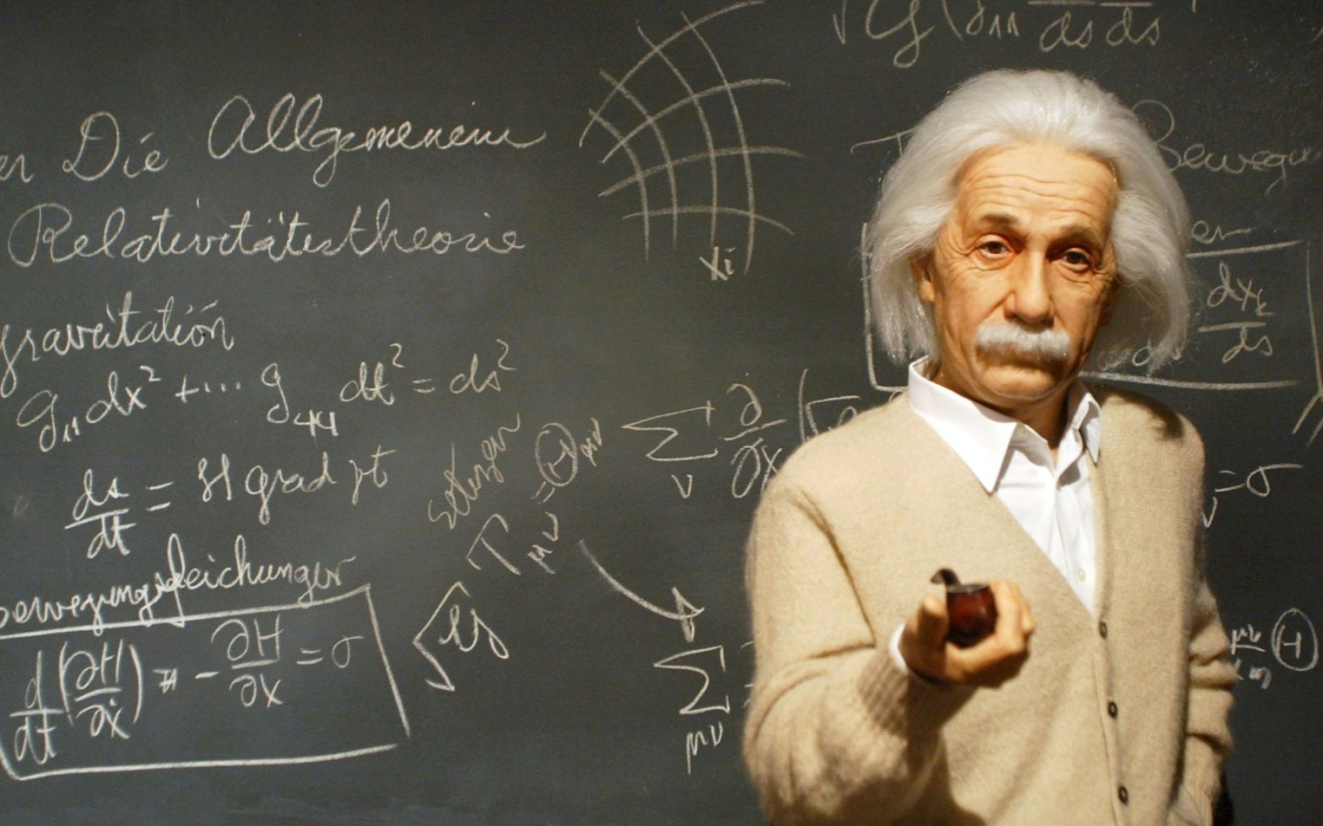
Jesus’ Word shows the destination

Slide 9
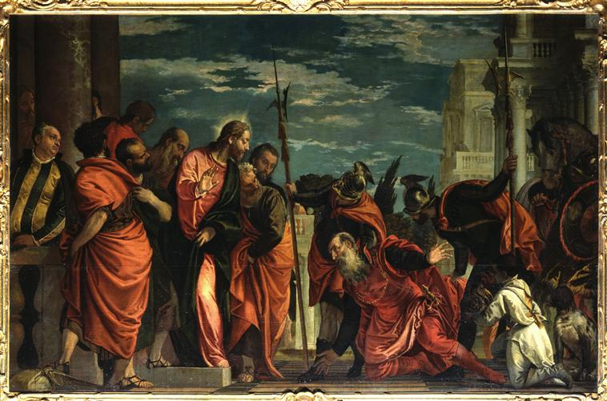
Jesus’ Word is as good as His presence
John chapter 4.
The king’s official’s son was sick in Capernaum
He rushed to Cana to ask Jesus’ help
“The royal official said, "Sir, come down before my child dies." (John 4:49)
Jesus’ shocking response: „ Jesus replied, "You may go. Your son will live." The man took Jesus at his word and departed.” (John 4:50

Slide 10
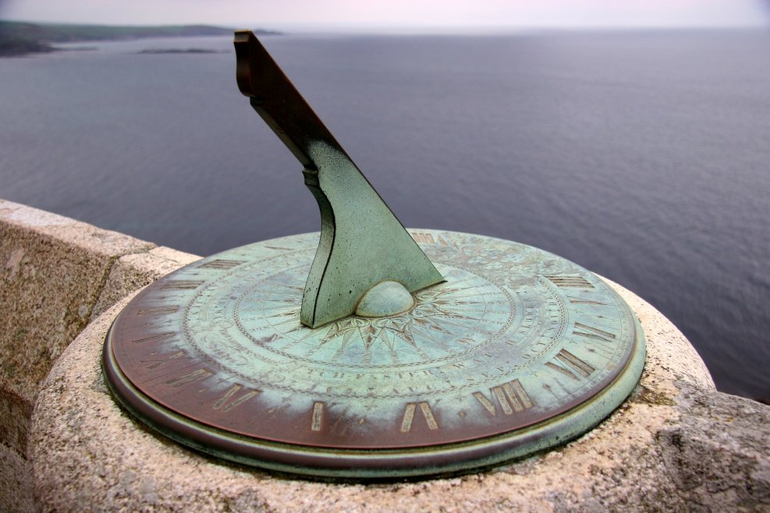
Words of Truth = Jesus’ Words
“When he inquired as to the time when his son got better, they said to him, "The fever left him yesterday at the seventh hour." Then the father realized that this was the exact time at which Jesus had said to him, "Your son will live." So he and all his household believed.” (John 4:52-53)

Slide 11
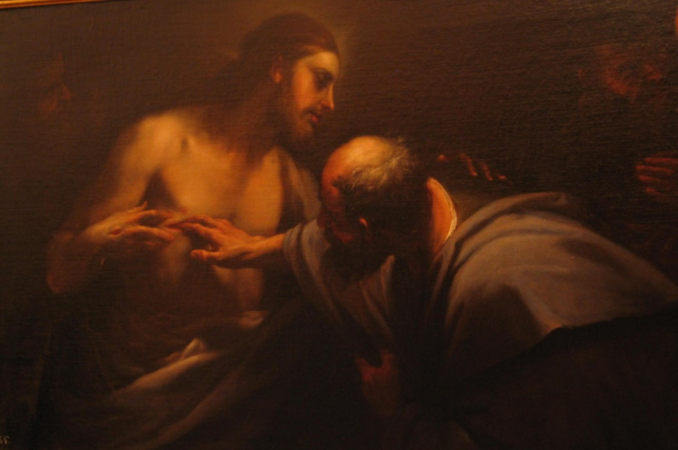
We have a little bit of Thomas in us
„So the other disciples told him, "We have seen the Lord!" But he said to them, "Unless I see the nail marks in his hands and put my finger where the nails were, and put my hand into his side, I will not believe it." (John 20:25)

Slide 12
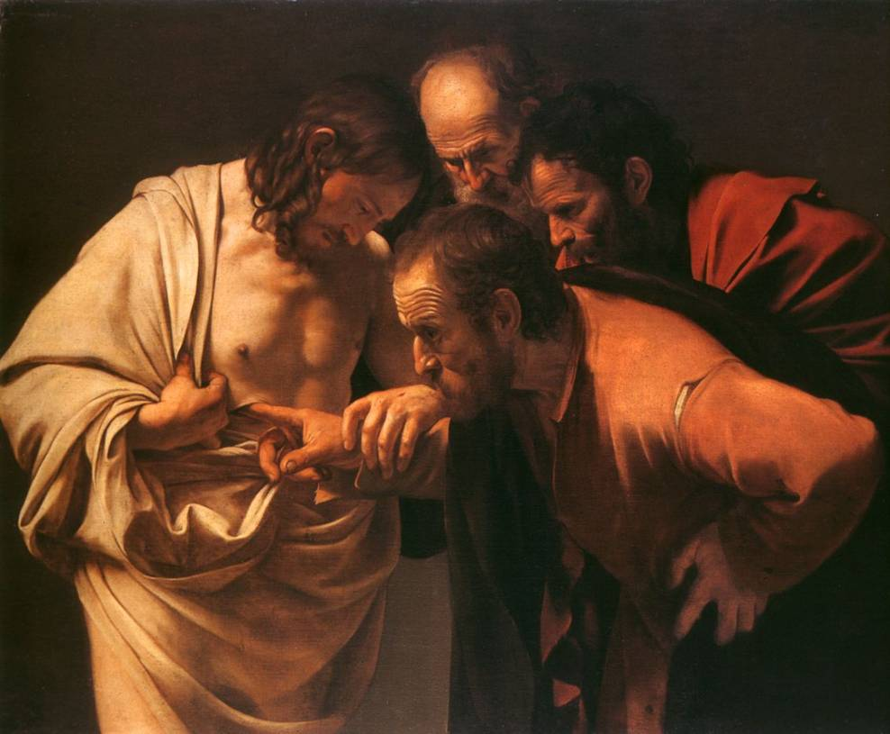
Bring your doubts to Jesus
”A week later his disciples were in the house again, and Thomas was with them. Though the doors were locked, Jesus came and stood among them and said, "Peace be with you!" Then he said to Thomas, "Put your finger here; see my hands. Reach out your hand and put it into my side. Stop doubting and believe. "Thomas said to him, "My Lord and my God!" (John 20:26-28)

Slide 13

Trust in my actions
“In my Father's house are many rooms; if it were not so, I would have told you. I am going there to prepare a place for you.” (John 14:2)
Jesus is using the image of two very familiar contemporary practices in order to illustrate His actions: the pictures of the journey and of the wedding

Slide 14
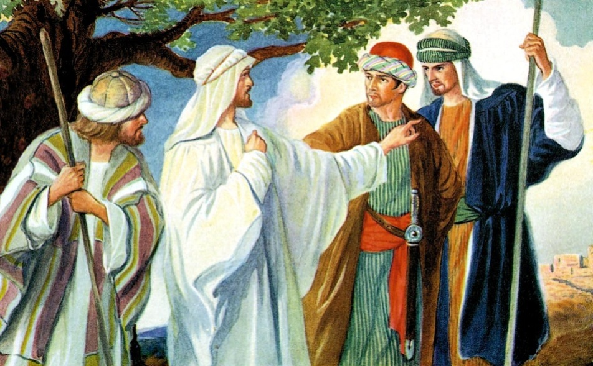
Interesting travelling custom
They sent some of their party on in advance
to find lodging and make arrangements
Many a time a disciple went ahead of Christ to make arrangements before He arrived
We have the same duty

Slide 15
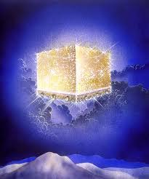
Biblical expressions about heaven
"a country" indicating the vastness of heaven
"a city" indicating the number of inhabitants
"a kingdom" indicating that there is a governmental structure to it all
"paradise" indicating its beauty and desirability
here it is called, "My Father’s house," and that is another way of saying, "It is home."

Slide 16

“HOME”
Home is a place where you can be yourself
Home is where you can take off your tie and kick off your shoes
Home is where you can say what you are thinking
Home is where you’re always accepted and loved
You’re not just a guest. You are a resident. You live there. That is home!

Slide 17
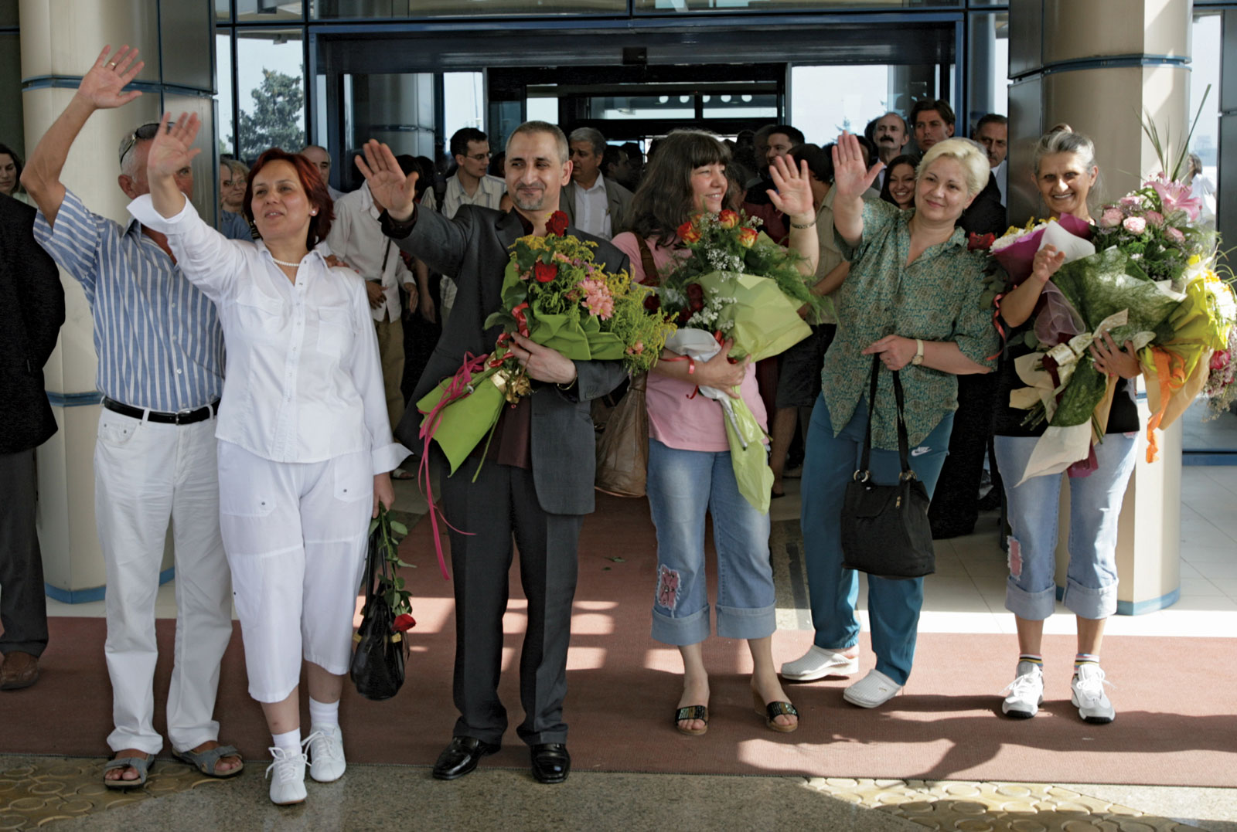
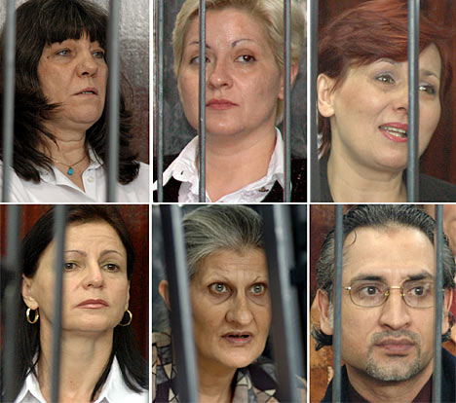
Health workers from Bulgaria

Slide 18
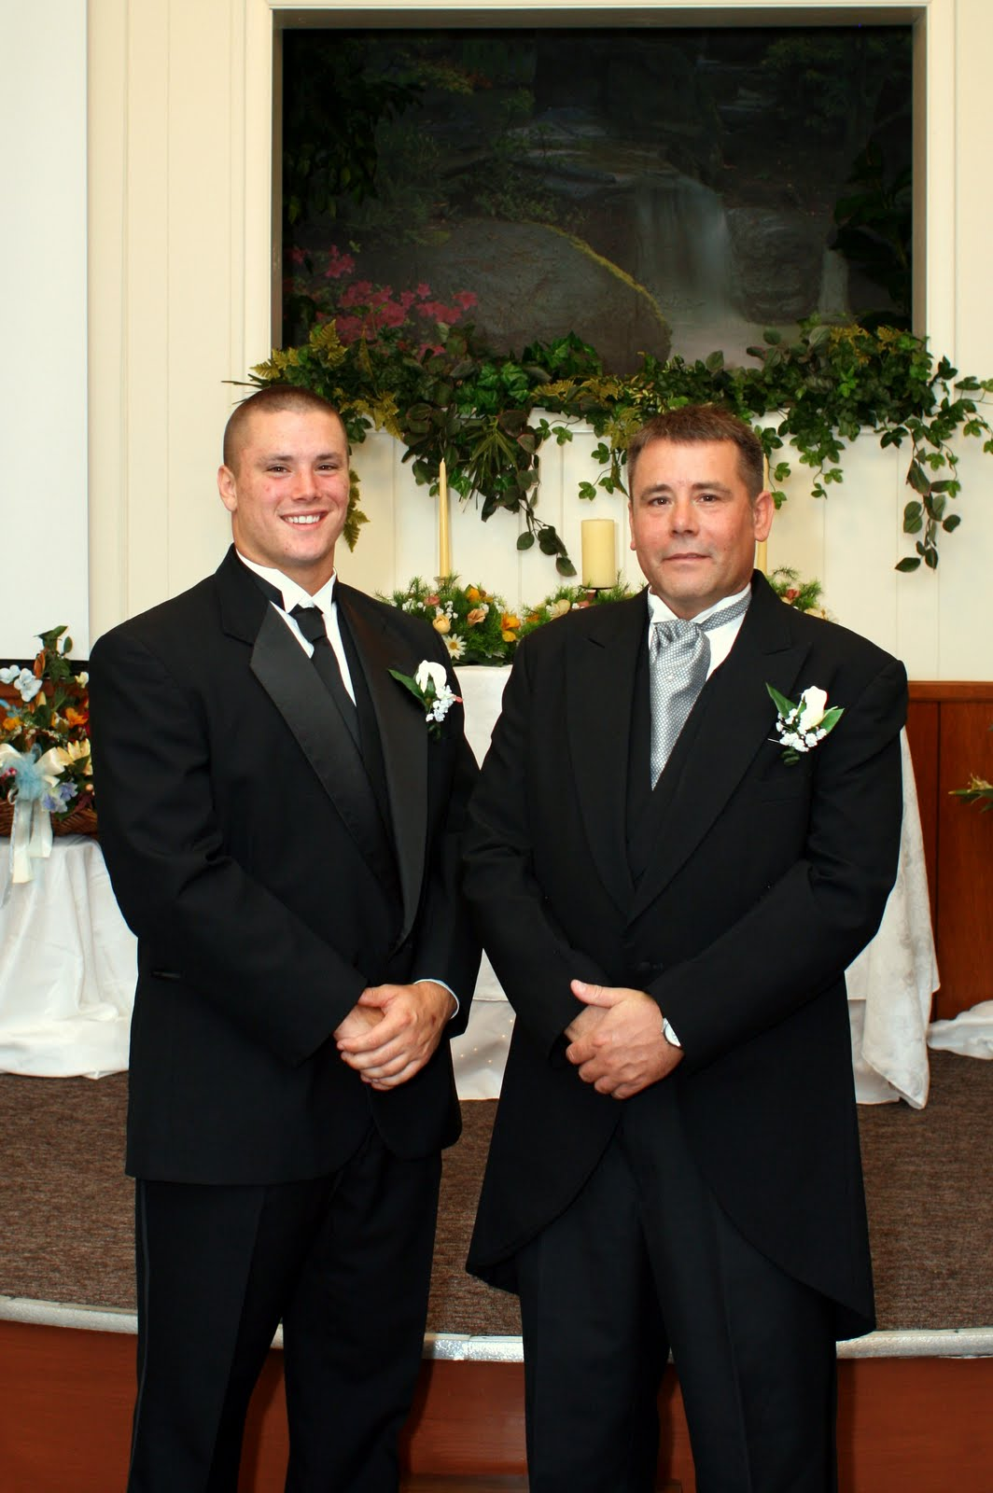
Wedding customs
When a son grew up and reached the adult age
Went to his father and announced that he found the one he loves, and he wanted to get married with her
The father suggested that they would build another room to the house – so they can have a home
They started building right away
As soon as the place was ready the father gave permission to his son to bring his bride home

Slide 19
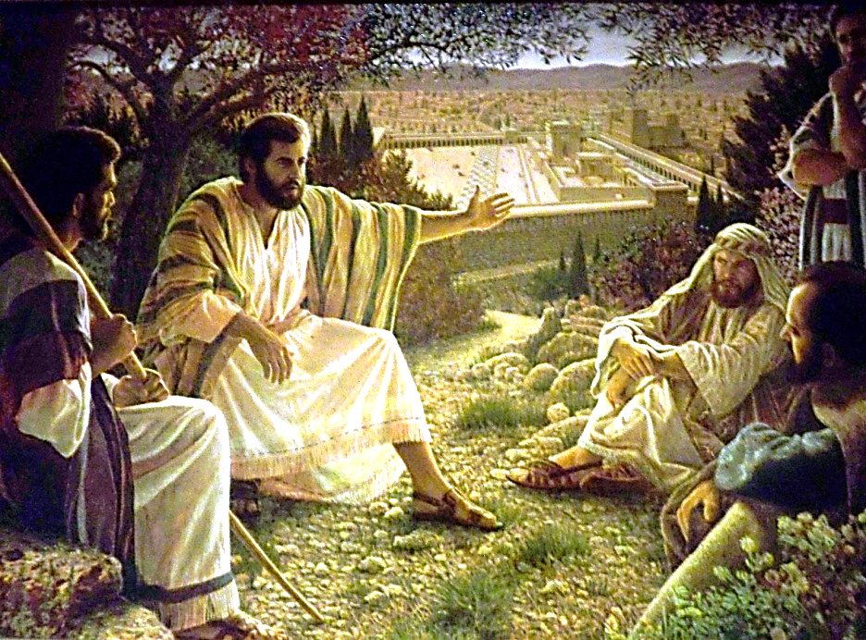
Trust His Promises!
“You know the way to the place where I am going." (John 14:4)
Thomas was not sure of the way and of the destination.
“Thomas said to him, "Lord, we don't know where you are going, so how can we know the way?" (John 14:5)
Many are seeking the way despite the fact that the road is just ahead of them
"Jesus answered, "I am the way and the truth and the life. No one comes to the Father except through me”. (John 14:6)
Everybody comes to the Father through Jesus Christ.

Slide 20
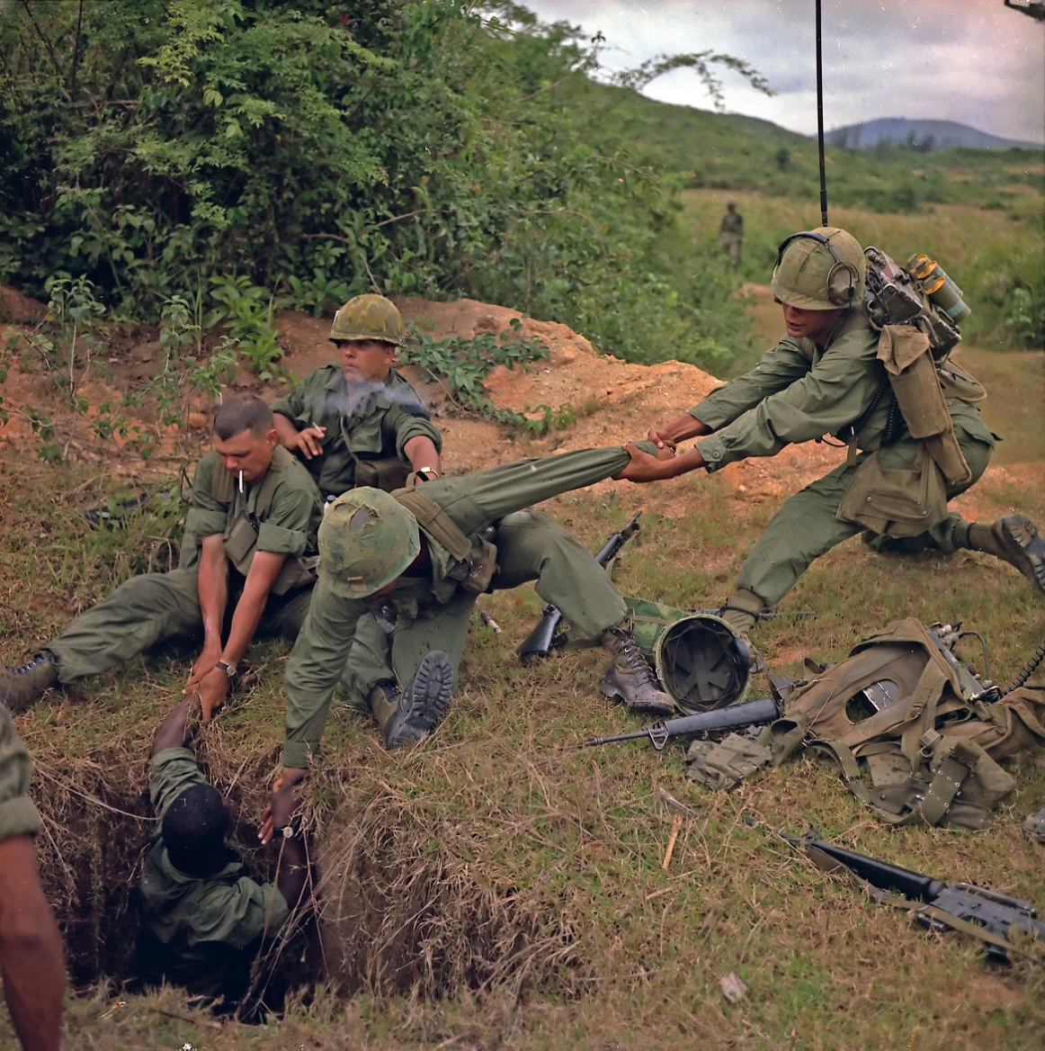

Slide 21
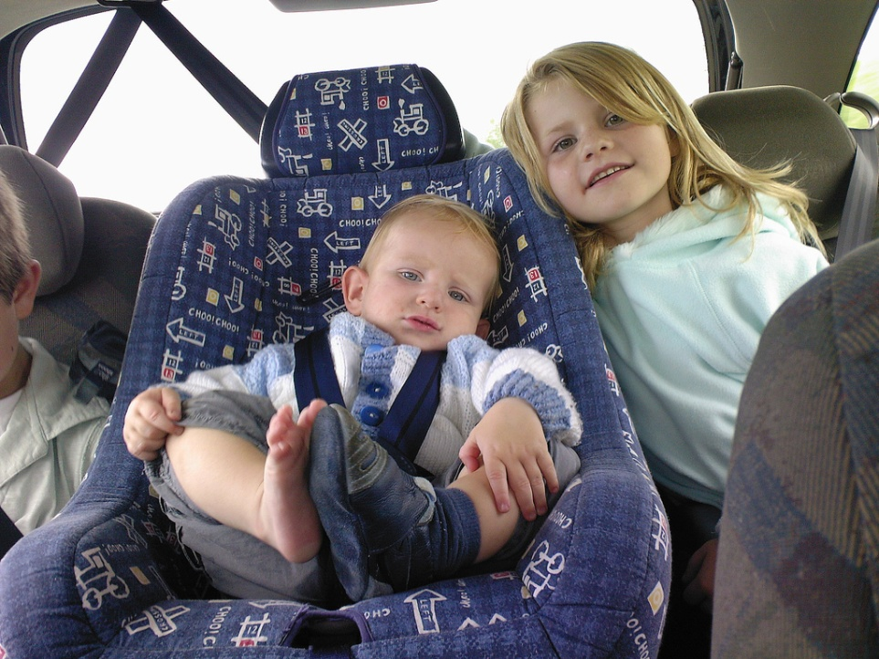
How can we be ready to meet Him?
Question of children: "When do we get there?
Waiting room – variety of waiting types
God is neither hurried nor delayed
"The Lord is not slow in keeping his promise, as some understand slowness. He is patient with you, not wanting anyone to perish, but everyone to come to repentance.” (2 Pet 3:9)

Slide 22
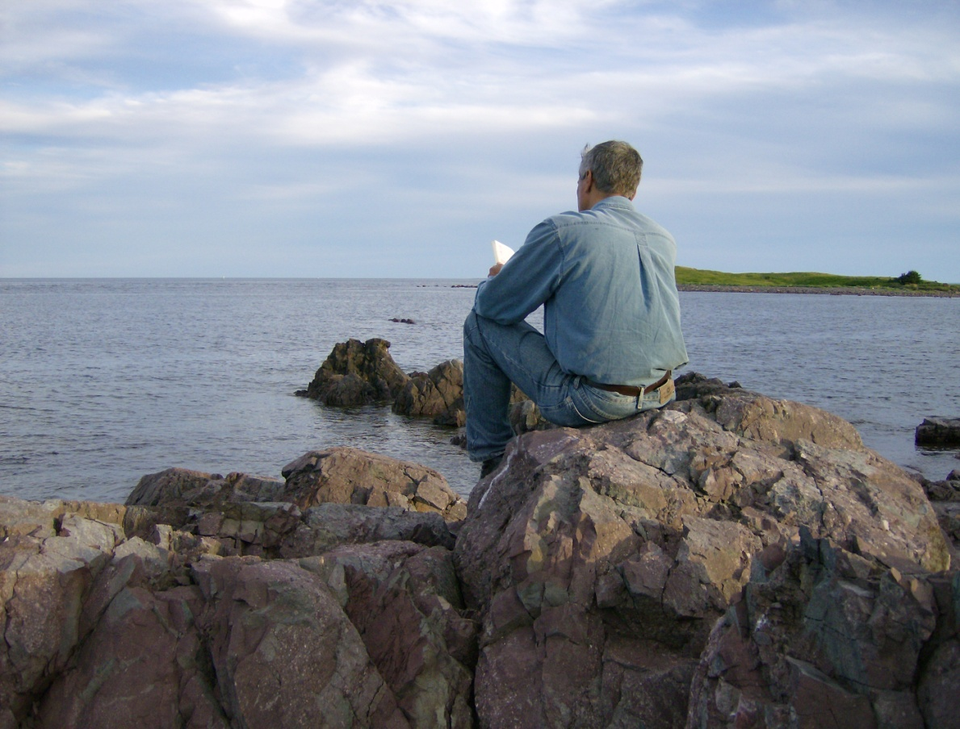
Waiting thoughts
What do you spend your time or your money on?
Are these eternal investments?
C.S. Lewis said: "All that is not eternal is eternally useless!"
Apostle Paul’s advice is quite timely: "Set your minds on things above, not on earthly things.” (Col 3:2)

Slide 23

Waiting with confidence in crisis
"Not only so, but we also rejoice in our sufferings, because we know that suffering produces perseverance; perseverance, character; and character, hope.” (Rom 5:3.4)
We do not really pray that God will bring tests and hardships
the difficulties of life are preparing us to meet the Son of God
Patience is needed for the preparation

Slide 24
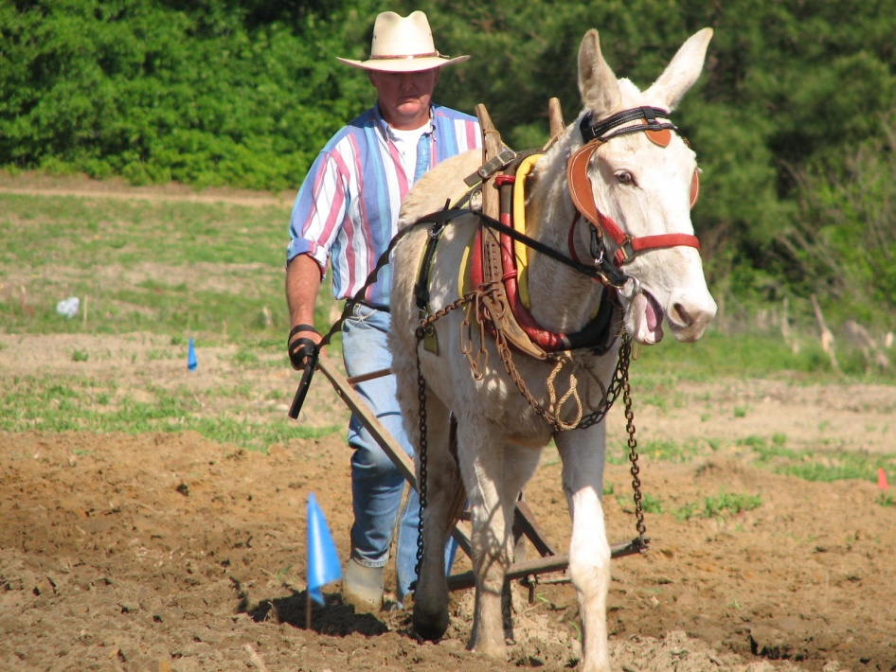
The ploughman
"Be patient, then, brothers, until the Lord's coming. See how the farmer waits for the land to yield its valuable crop and how patient he is for the autumn and spring rains. You too, be patient and stand firm, because the Lord's coming is near.” (James 5:7-8)

Slide 25
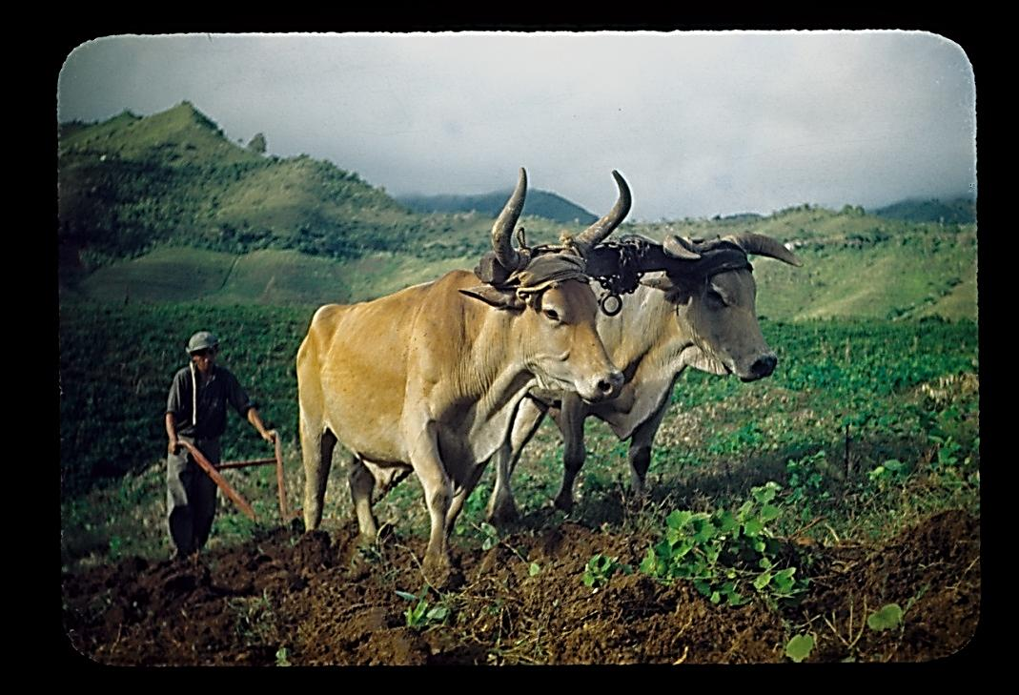
The ploughman
Don't grumble against each other, brothers, or you will be judged. The Judge is standing at the door! Brothers, as an example of patience in the face of suffering, take the prophets who spoke in the name of the Lord. As you know, we consider blessed those who have persevered. You have heard of Job's perseverance and have seen what the Lord finally brought about. The Lord is full of compassion and mercy.” (James 5:9-11)

Slide 26
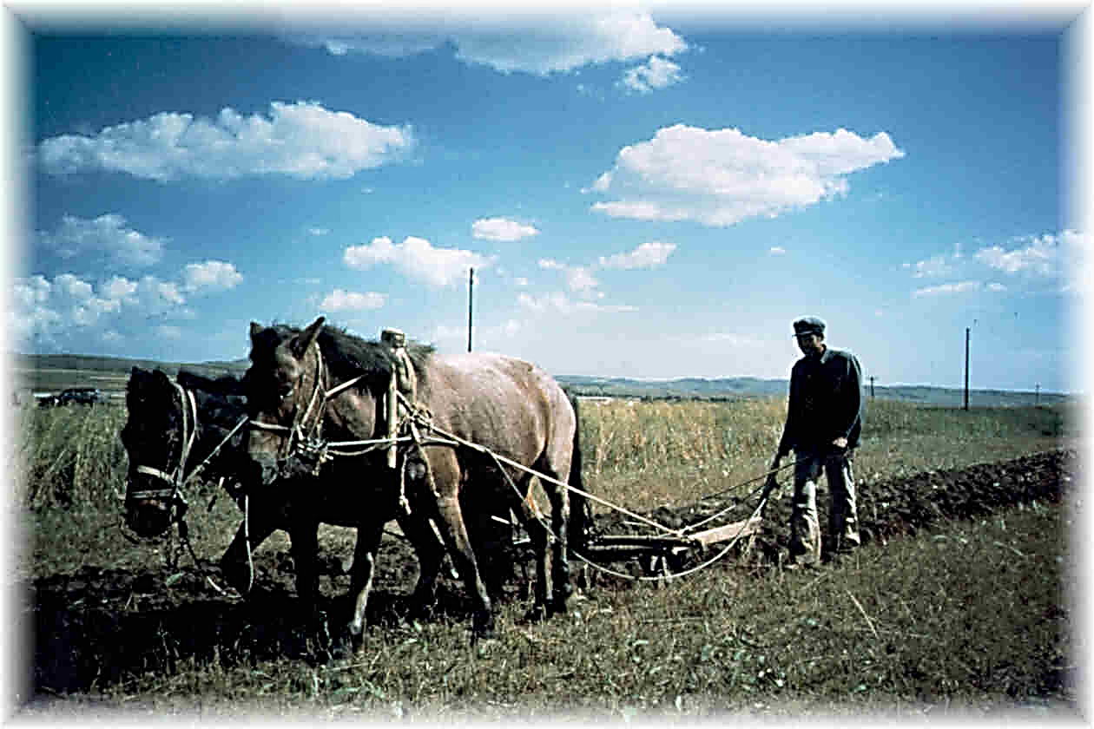
Why is the apparent delay?
Jesus did not give up on the salvation of this world
Many people have had enough of the sufferings of this world.
Many people seem to sigh: "Amen. Come, Lord Jesus" (Revelation 22:20).
What is the ploughman really doing?
He is working, then he is waiting.
He acknowledges his dependence on God.
He is not waiting in vain!

Slide 27
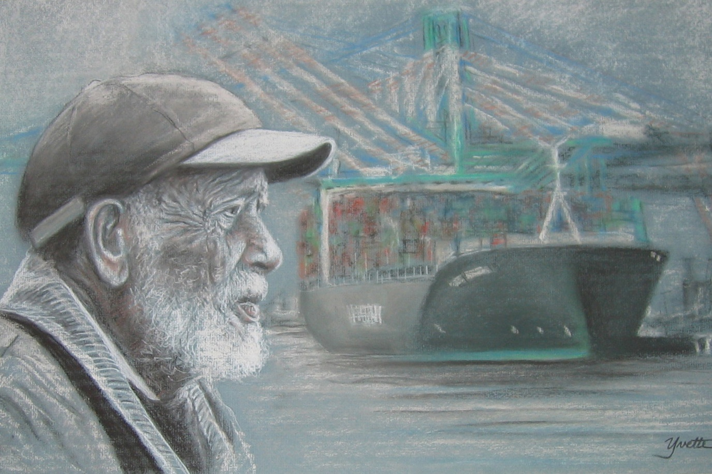
He promised He would come

Slide 28
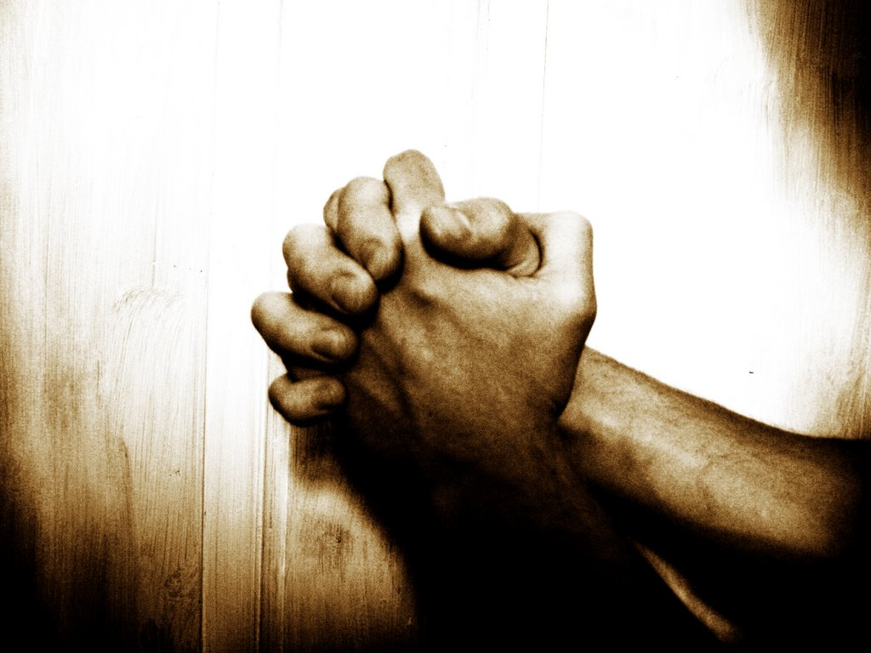
"We all desire the joy of that day… If someone is not yet ready to desire this day, then he does not understand the Lord's Prayer, and cannot pray it from the heart.“ /Martin Luther/

