Slide 1
“When the end of this
world is coming”

Slide 2
Summary
1. Introduction – Columbia space shuttle
2. Signs of the end
3. Jesus’ coming – literal event
4. Two groups of people

Slide 3
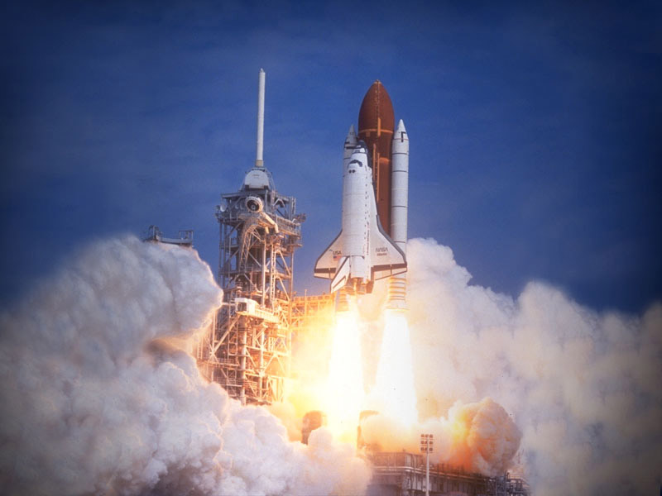

Slide 4
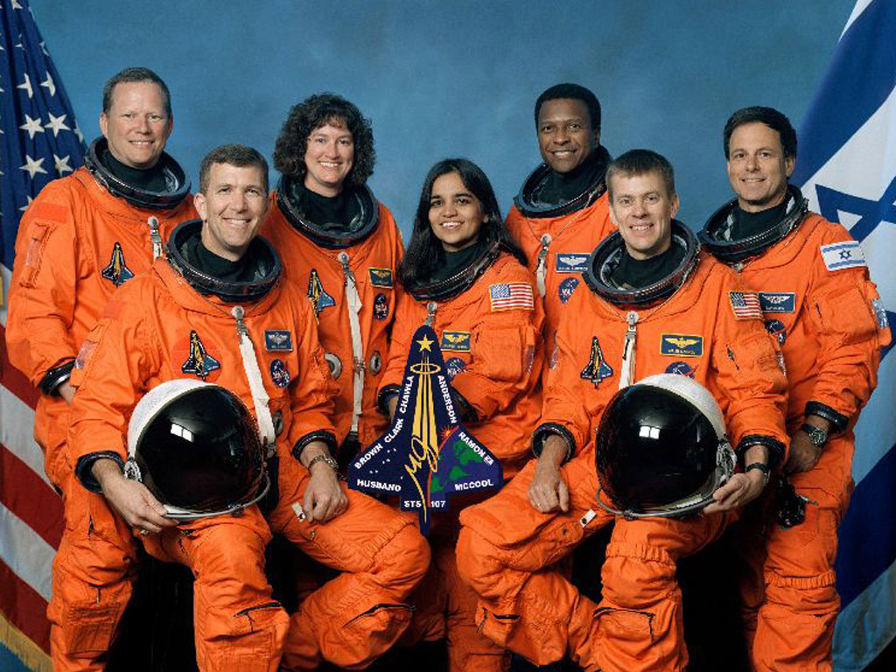

Slide 5
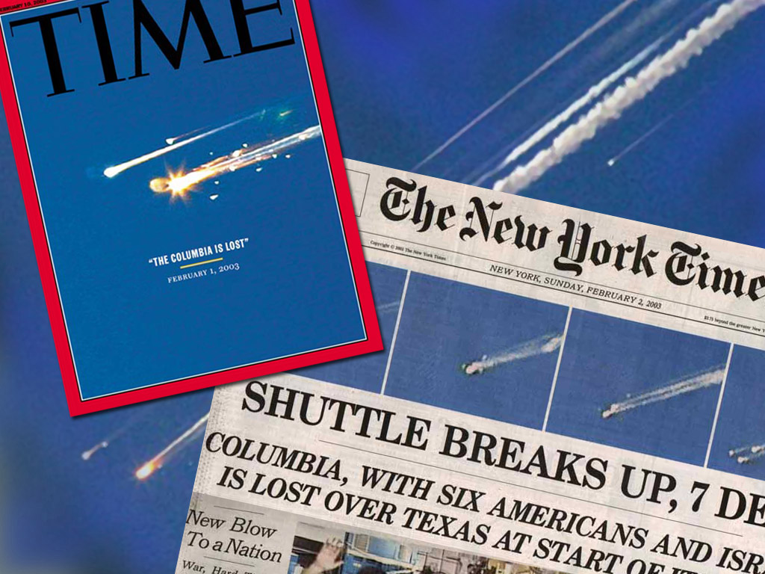

Slide 6


Slide 7
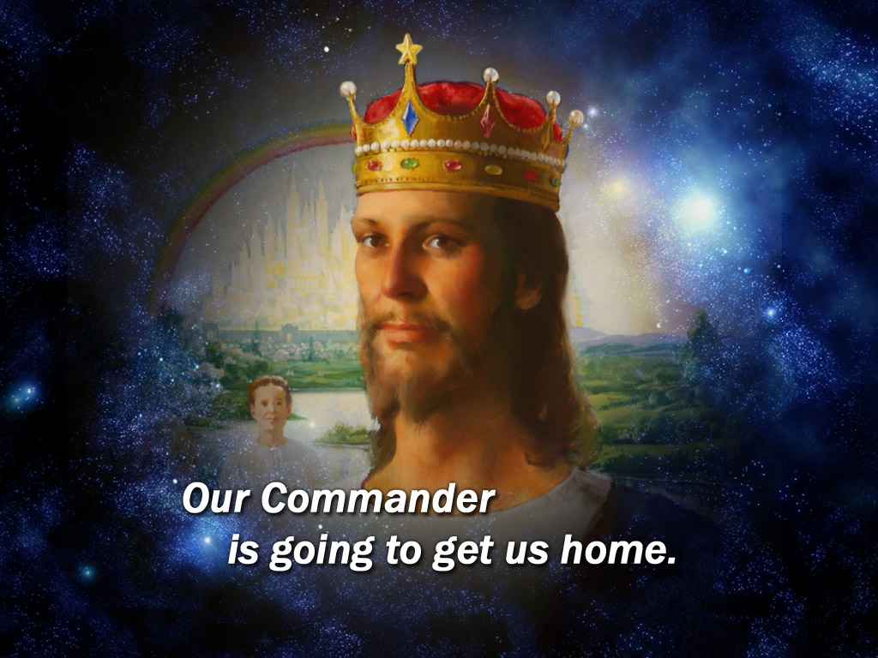

Slide 8
The end: when all will cry
^{NIV} Matthew 24:30 "At that time the sign of the Son of Man will appear in the sky, and all the nations of the earth will mourn. They will see the Son of Man coming on the clouds of the sky, with power and great glory.
^{NIV} Matthew 24:31 And he will send his angels with a loud trumpet call, and they will gather his elect from the four winds, from one end of the heavens to the other.

Slide 9
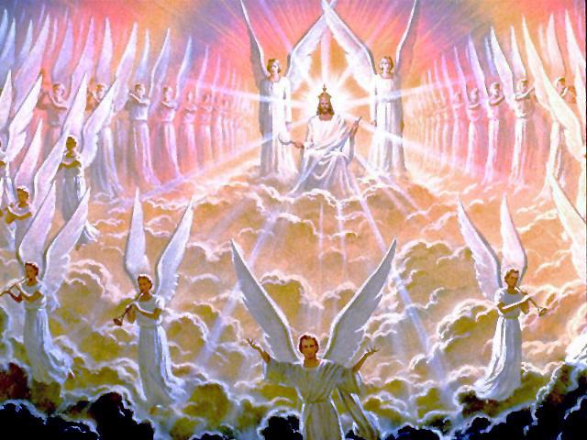

Slide 10
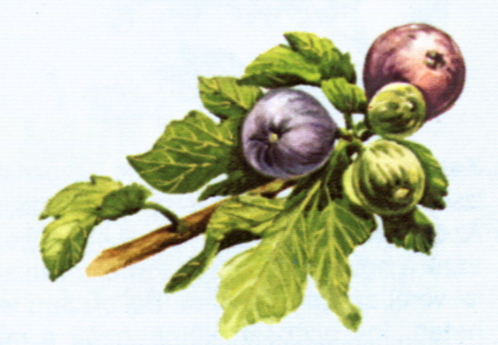
Fig tree...
^{NIV} Matthew 24:32 "Now learn this lesson from the fig tree: As soon as its twigs get tender and its leaves come out, you know that summer is near.

Slide 11
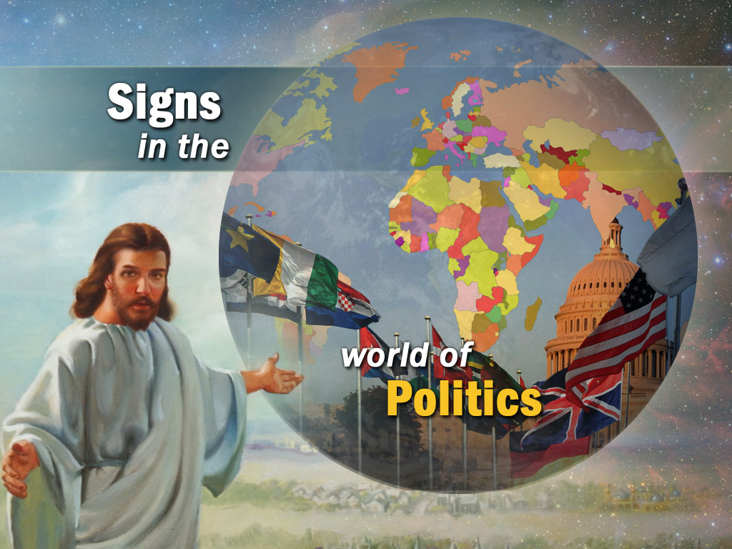

Slide 12
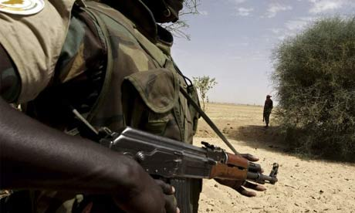
Signs about the End
^{NIV} Matthew 24:6 You will hear of wars and rumors of wars, but see to it that you are not alarmed. Such things must happen, but the end is still to come.

Slide 13


Slide 14


Slide 15
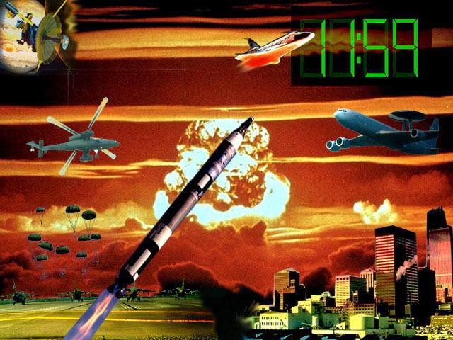

Slide 16
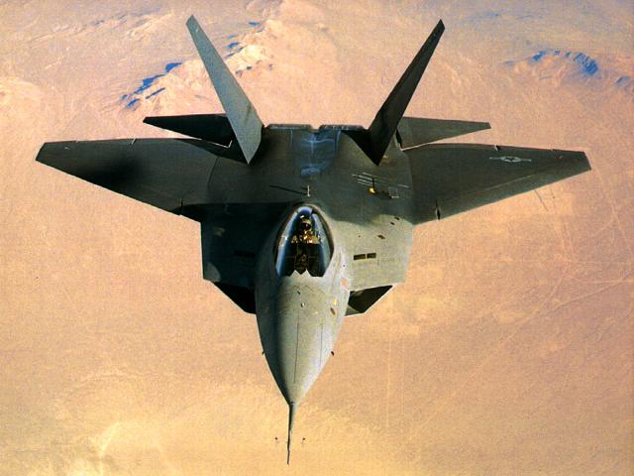

Slide 17
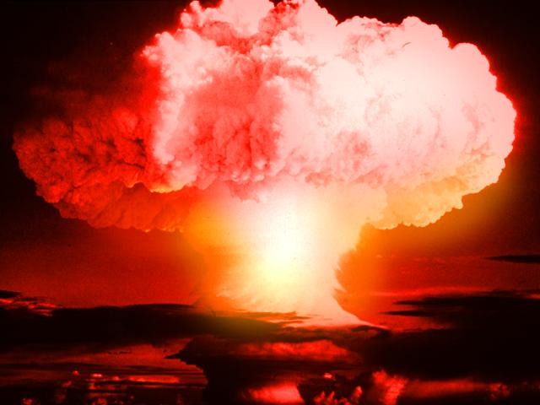

Slide 18
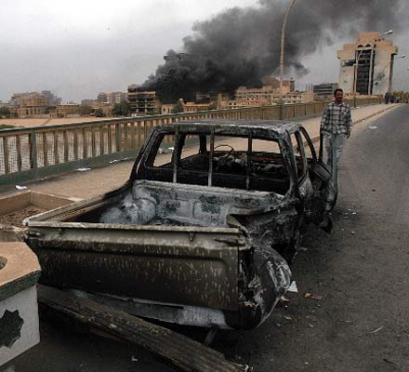
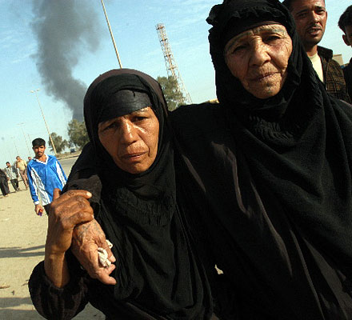

Slide 19
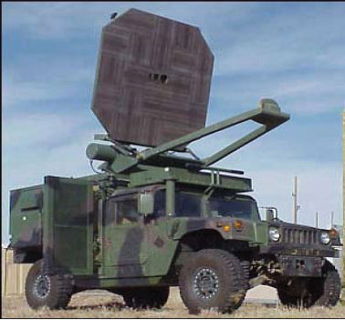
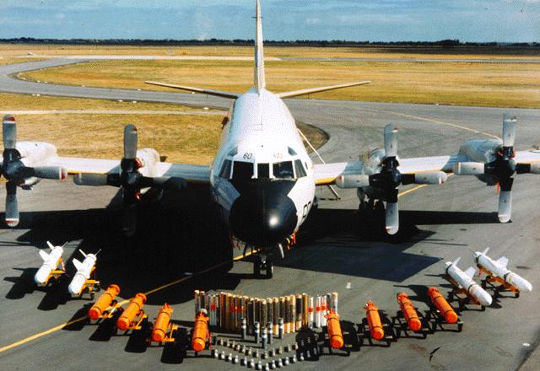
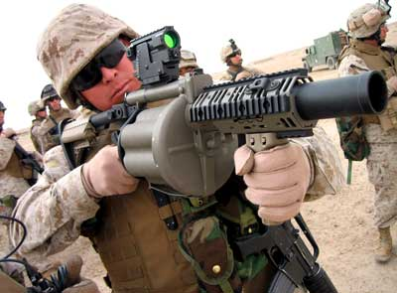

Slide 20
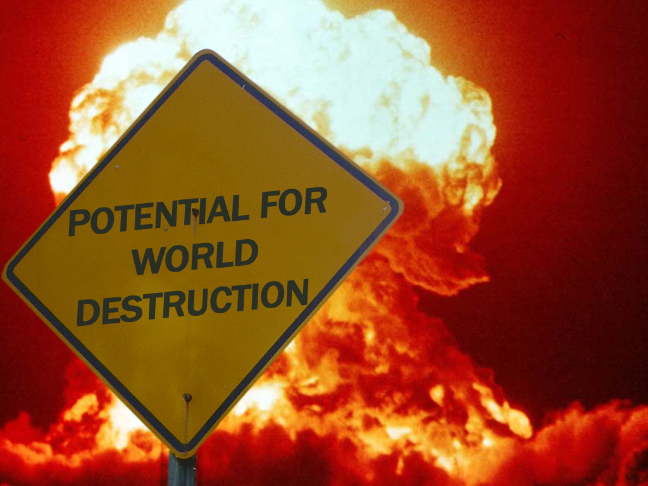

Slide 21
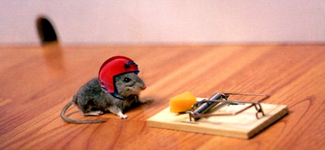
We are different than...

Slide 22
The Second World War did not end the fighting among nations
In the 20 Century there were 169 million democides, 118 million (or 70%) were victims of just three regimes -- the USSR, Communist China and Nazi Germany.

Slide 23
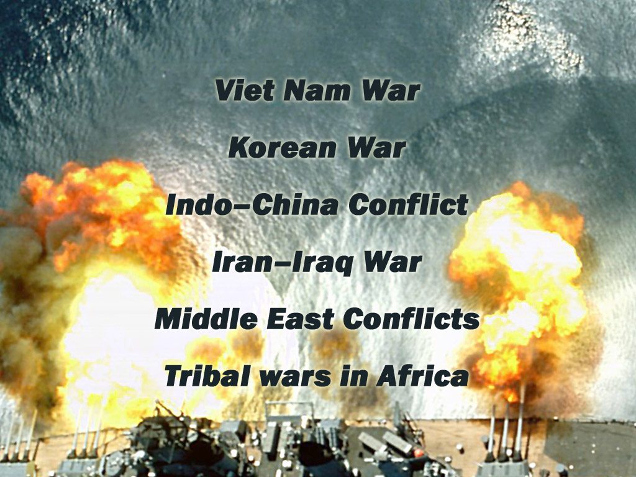

Slide 24
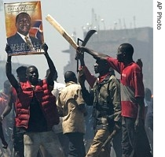
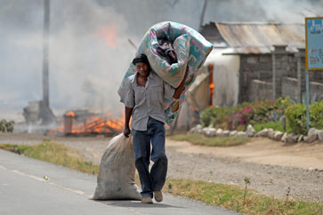
Kenya 2008

Slide 25
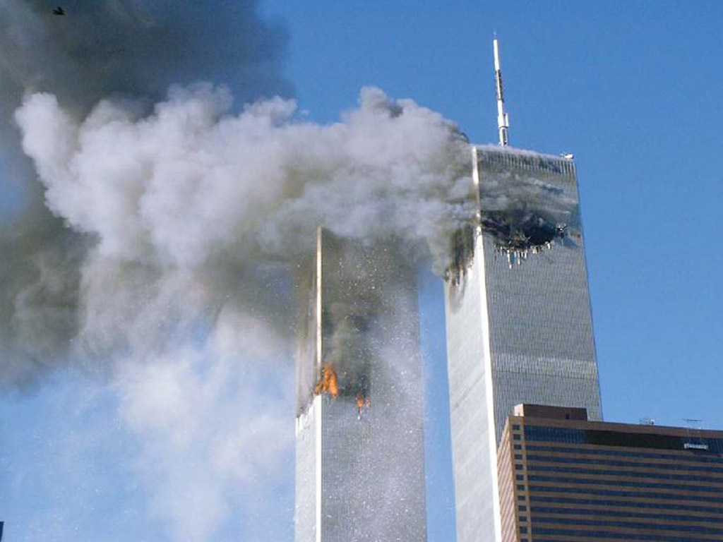
Terrorism

Slide 26
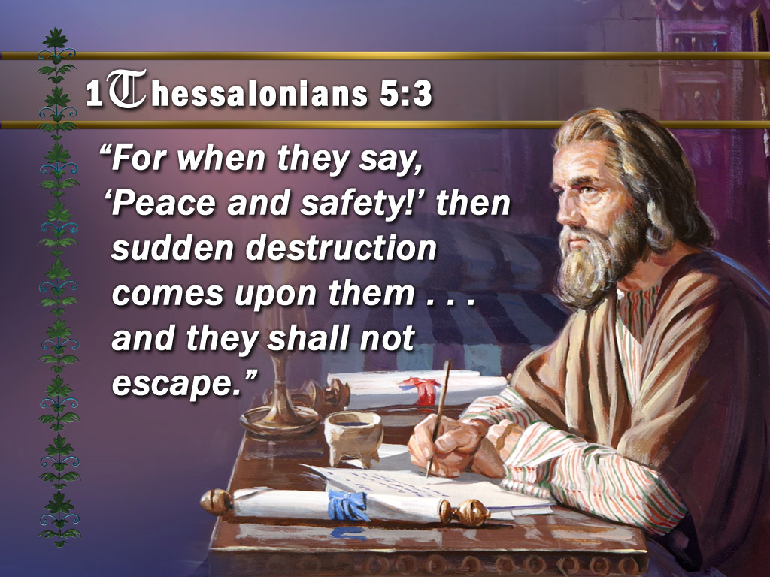

Slide 27
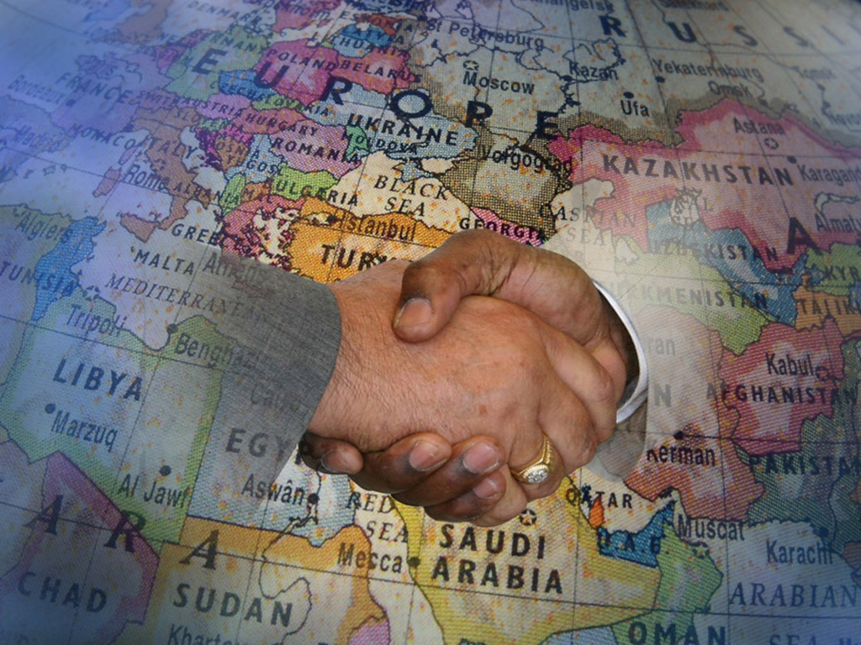

Slide 28
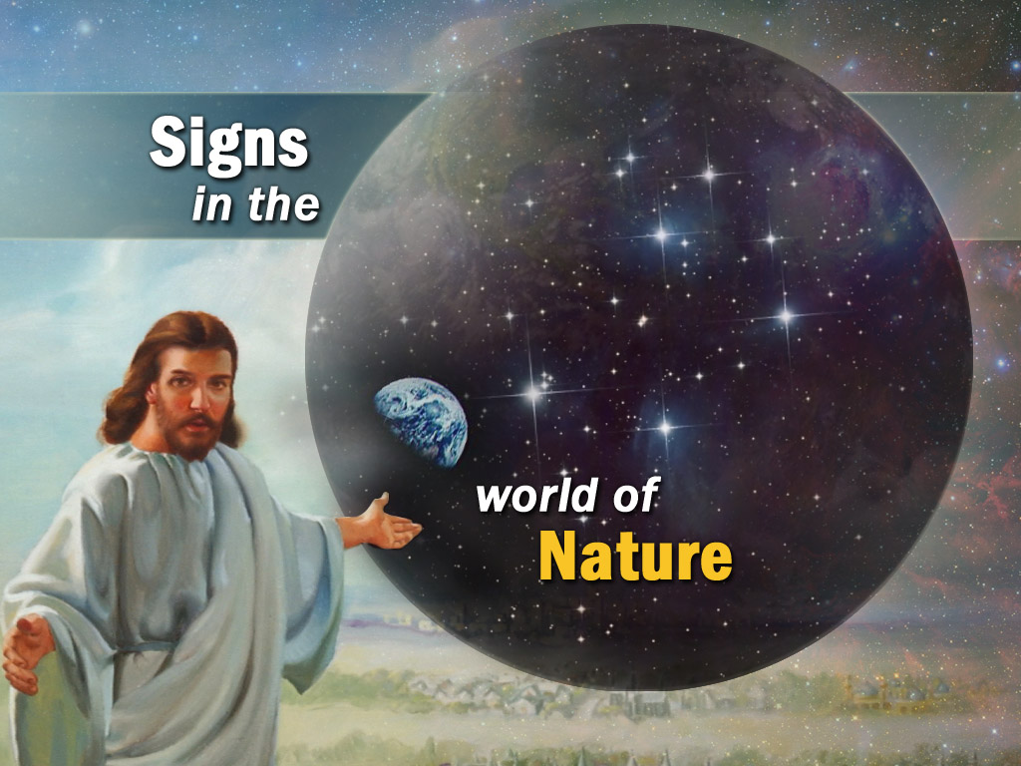

Slide 29
Signs of the Nature
^{KJV} Matthew 24:7b and there shall be famines, and pestilences, and earthquakes, in divers places.
There will be famines, epidemics and sicknesses
HIV / AIDS is one of the biggest threats
People living with HIV/AIDS in 2007 – 33 Million
More than 25 million people have died of AIDS since 1981
Africa has 11.6 million AIDS orphans

Slide 30
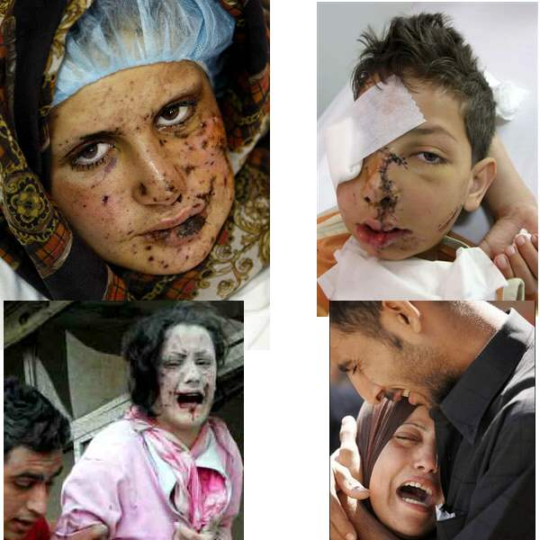

Slide 31
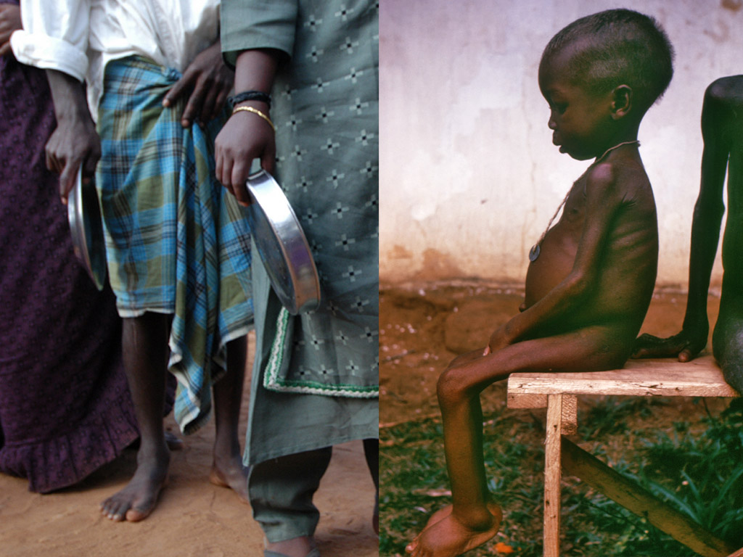

Slide 32
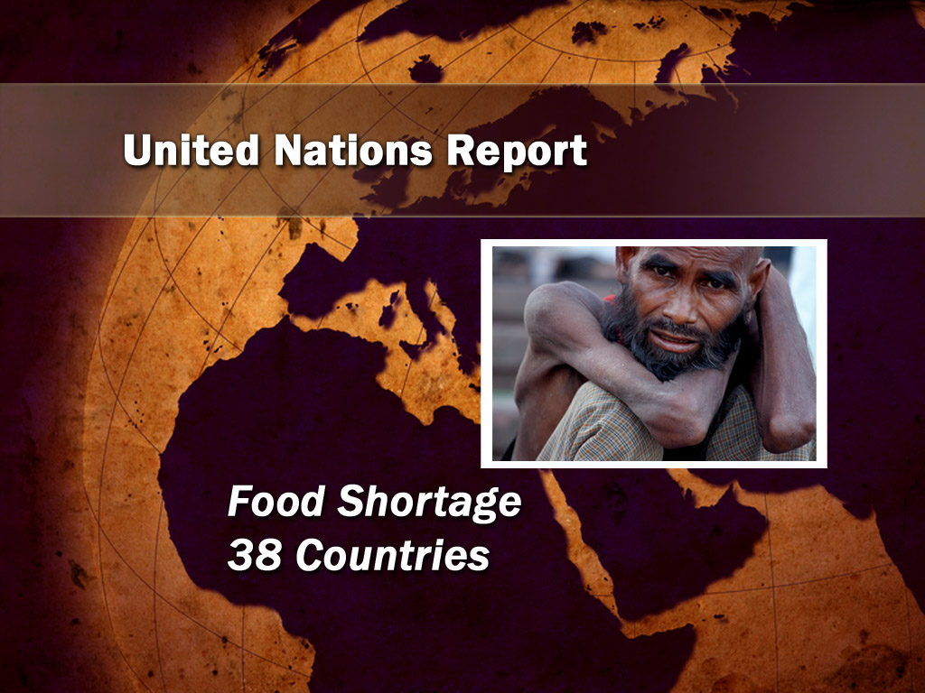

Slide 33
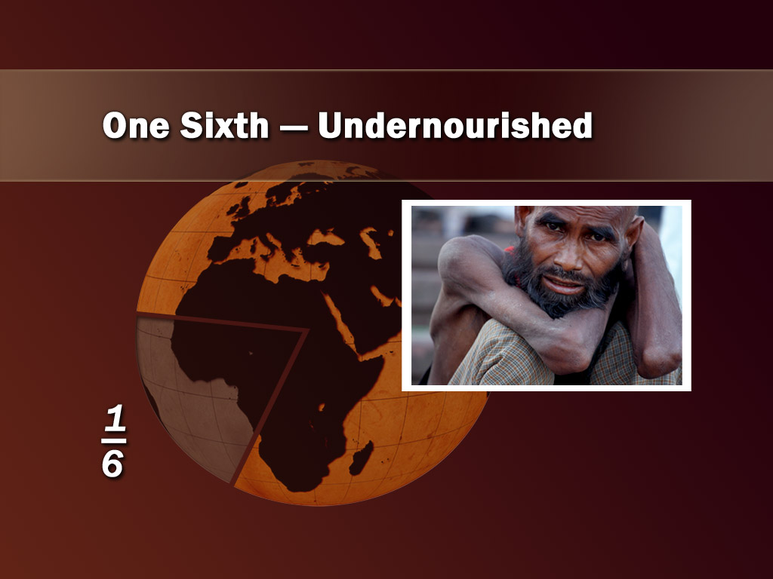

Slide 34
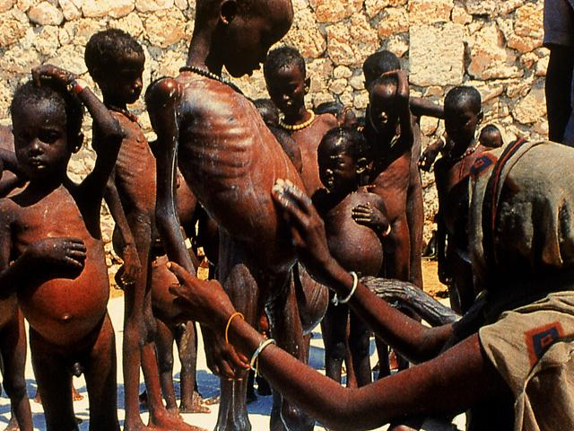

Slide 35
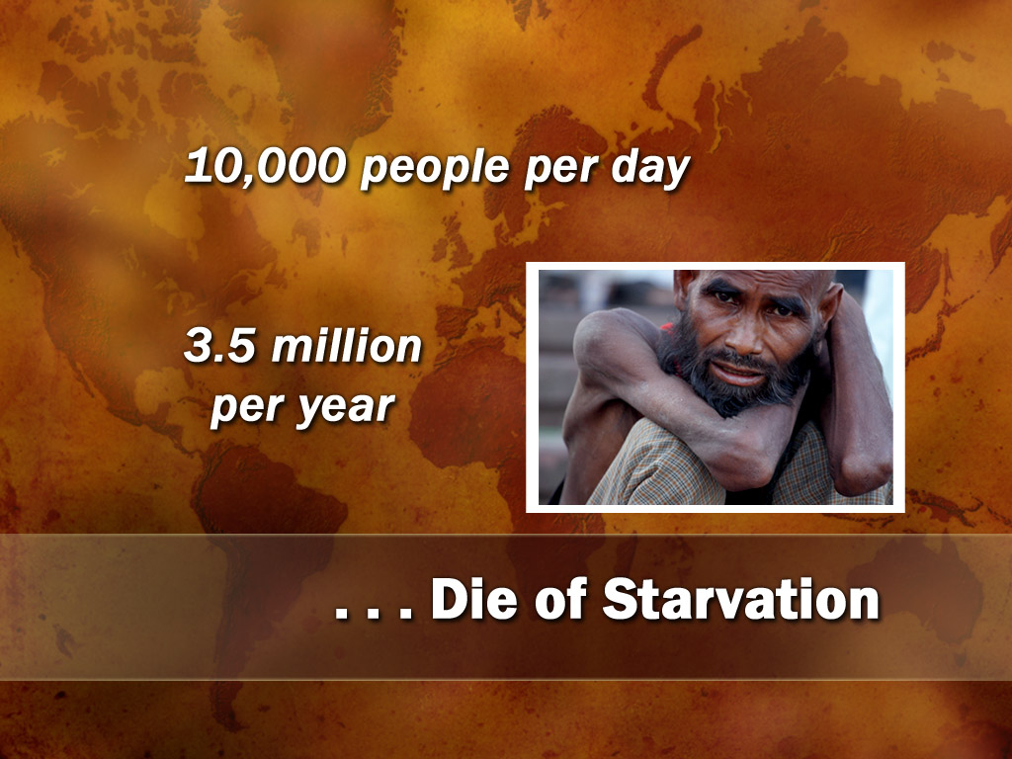

Slide 36
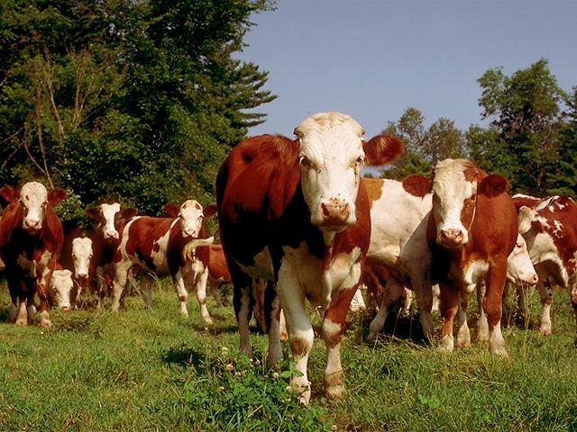

Slide 37
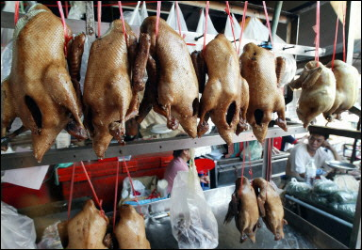

Slide 38
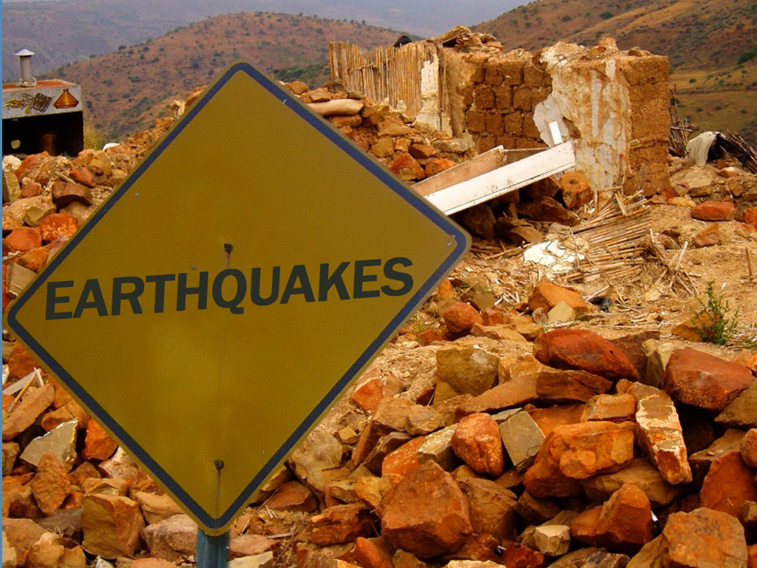

Slide 39
Earthquakes
We have 10 times as much earthquakes these days than a few decades ago.
“There have been many great earthquakes throughout history, but, according to surprisingly well-kept records, in the past they did not occur very frequently. The 20th century, however, has experienced an unprecedented increase in the frequency of these calamities. In fact, the number of earthquakes per decade has roughly doubled in each of the 10-year periods since 1950. /Richter/

Slide 40
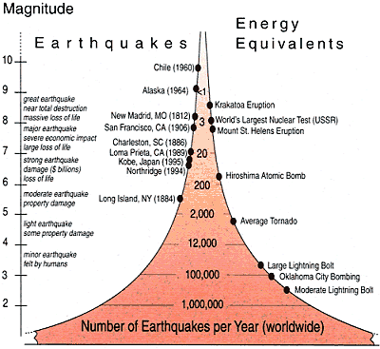

Slide 41
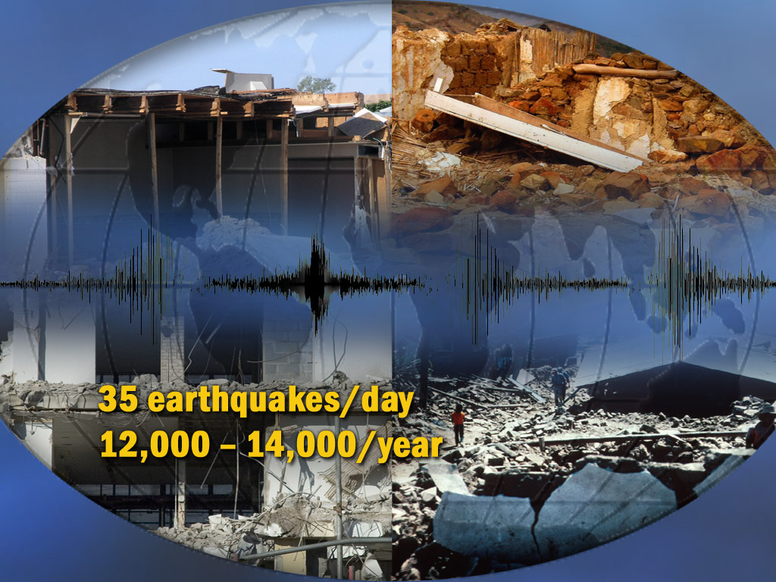

Slide 42
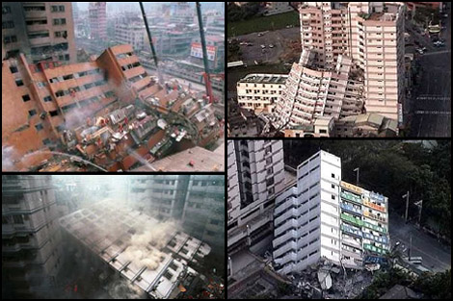
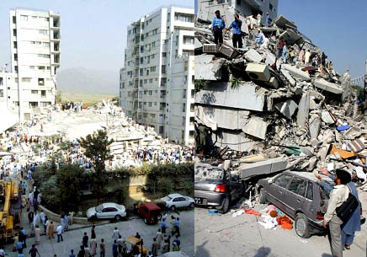
Earthquakes in Japan, Indonesia, Pakistan

Slide 43
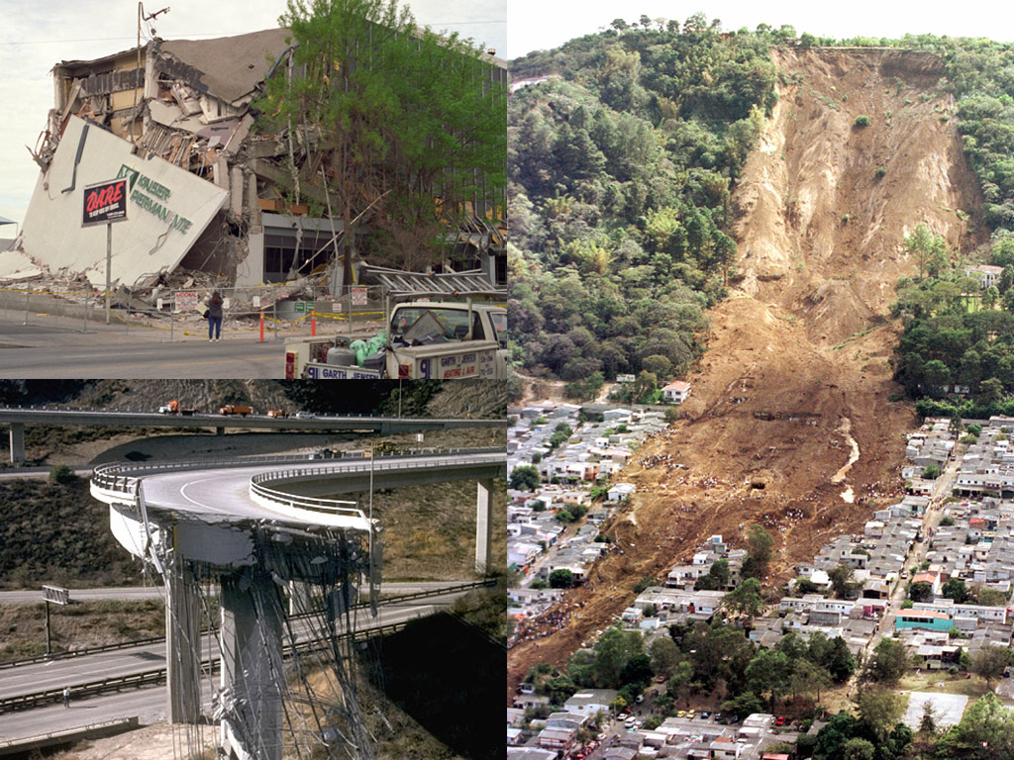

Slide 44
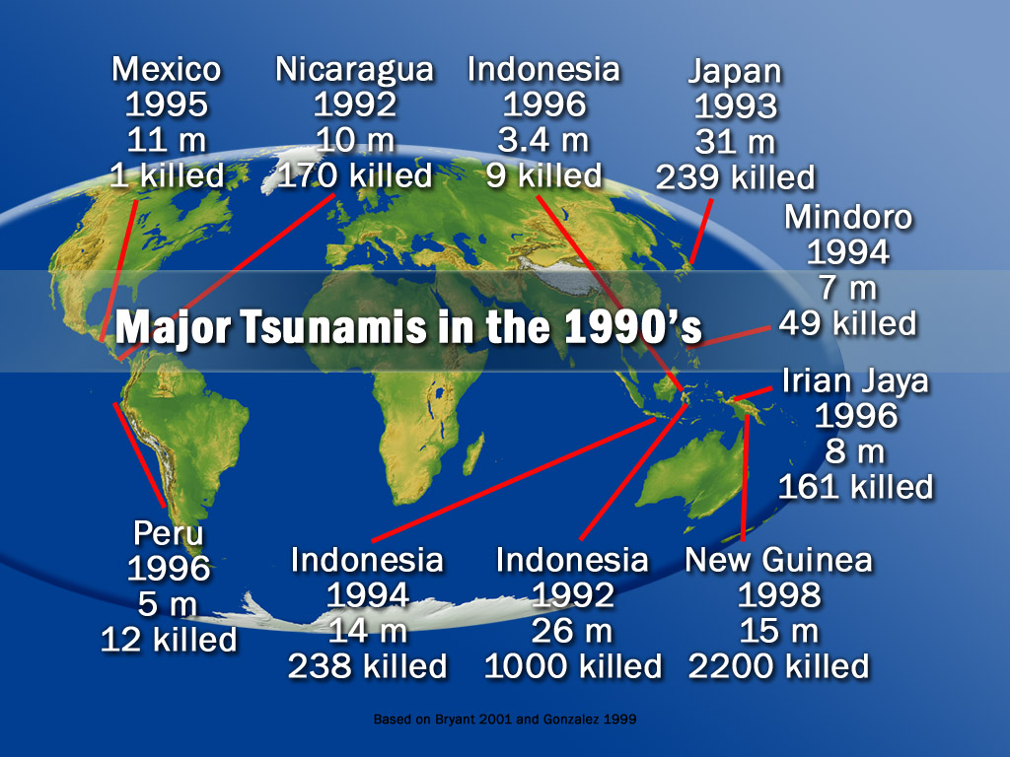

Slide 45
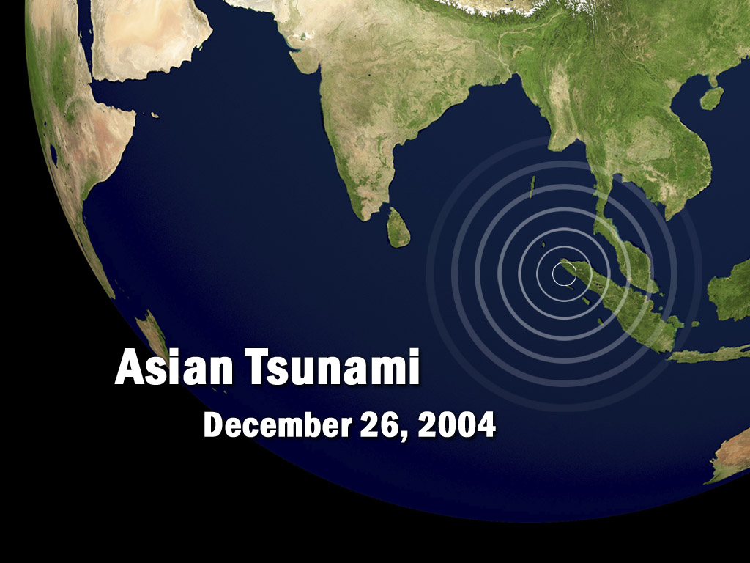

Slide 46
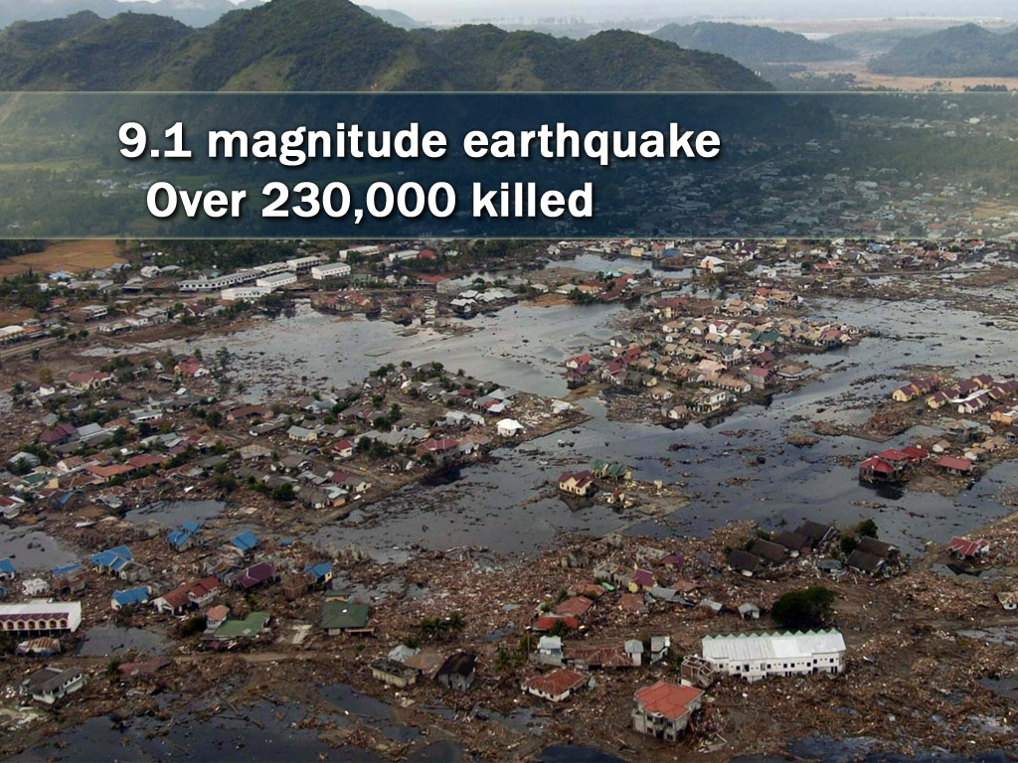

Slide 47
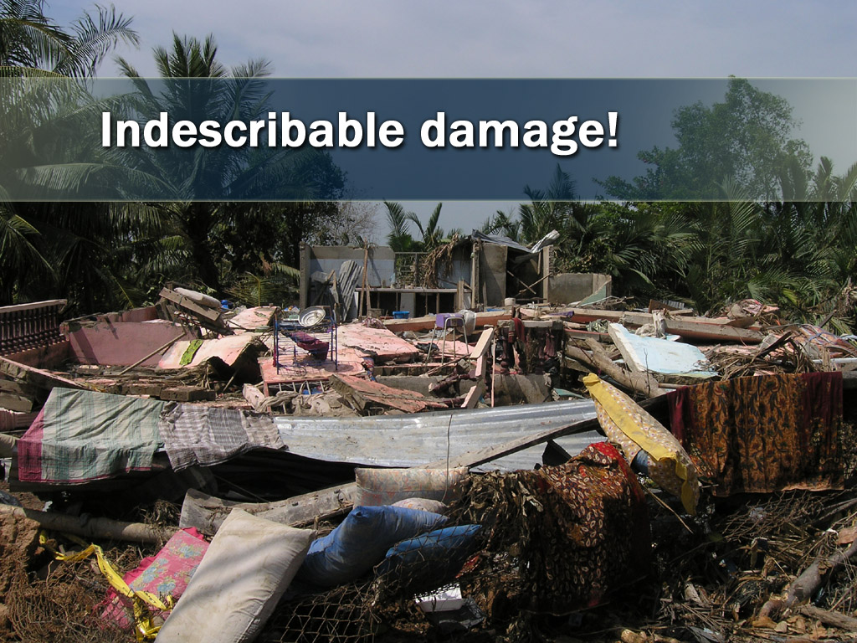

Slide 48
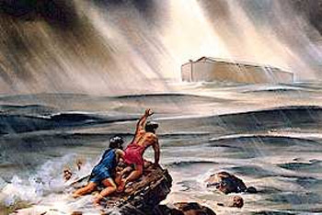
^{NIV} Luke 21:25.26 "There will be signs in the sun, moon and stars. On the earth, nations will be in anguish and perplexity at the roaring and tossing of the sea. Men will faint from terror, apprehensive of what is coming on the world, for the heavenly bodies will be shaken.”
There is a general unrest worldwide.

Slide 49
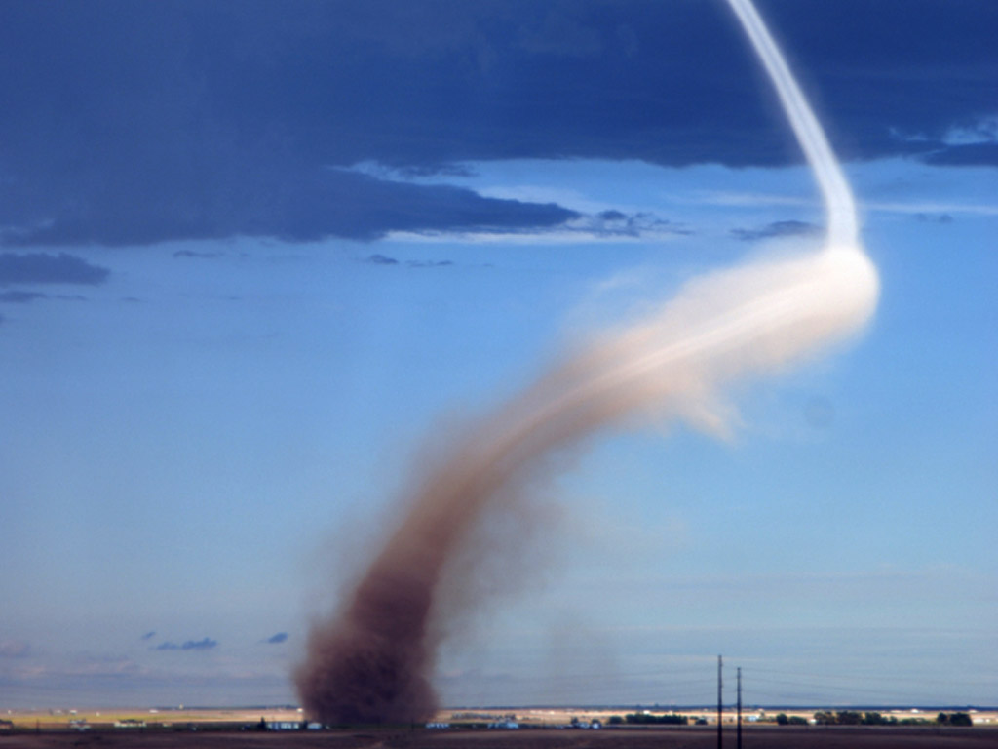

Slide 50
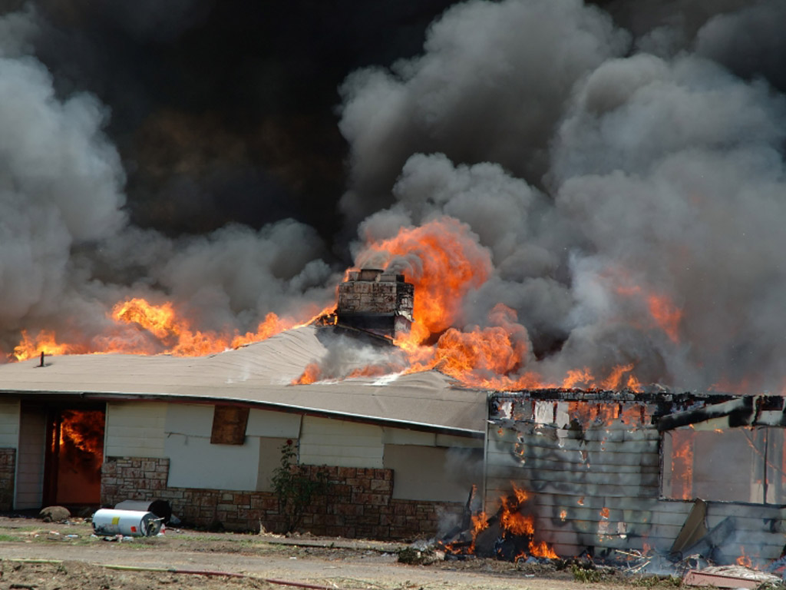

Slide 51
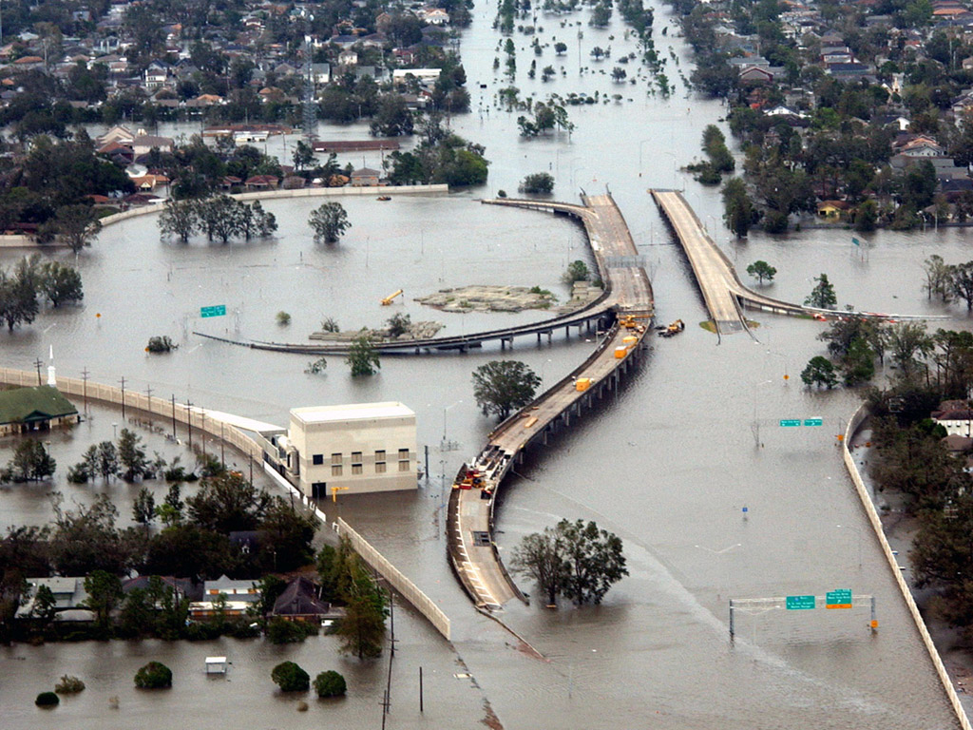

Slide 52
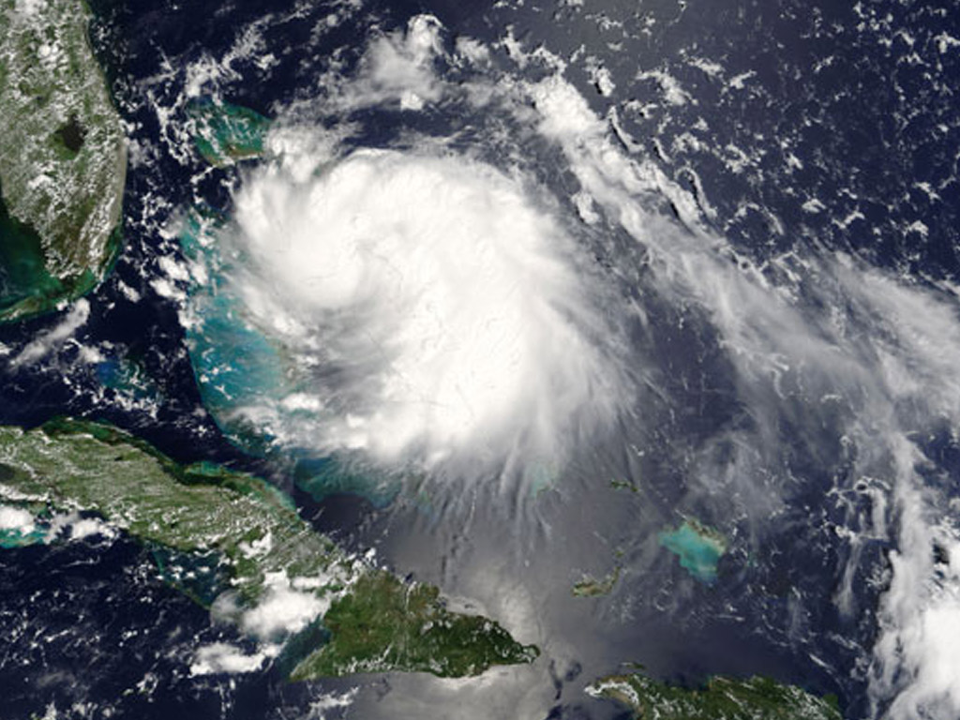

Slide 53
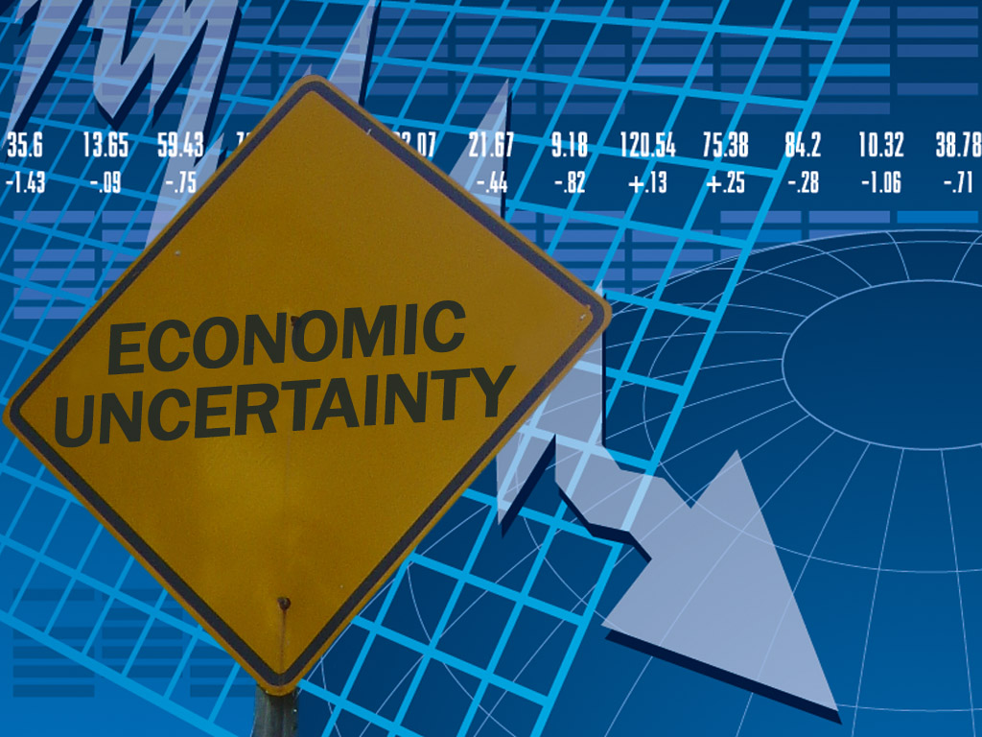

Slide 54
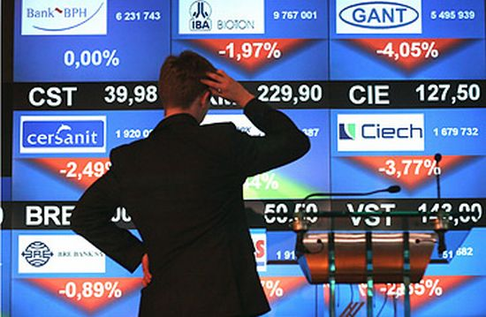


Slide 55


Slide 56


Slide 57
Immorality
^{NIV} Matthew 24:37-39 As it was in the days of Noah, so it will be at the coming of the Son of Man. For in the days before the flood, people were eating and drinking, marrying and giving in marriage, up to the day Noah entered the ark; and they knew nothing about what would happen until the flood came and took them all away. That is how it will be at the coming of the Son of Man.

Slide 58


Slide 59


Slide 60


Slide 61


Slide 62
Ignorance to the Gospel
^{NIV} Matthew 24:24 For false Christs and false prophets will appear and perform great signs and miracles to deceive even the elect-- if that were possible.

Slide 63



Know the original

Slide 64
Beware
^{NIV} Matthew 24:25.26 See, I have told you ahead of time. "So if anyone tells you, 'There he is, out in the desert,' do not go out; or, 'Here he is, in the inner rooms,' do not believe it.

Slide 65


Slide 66


Slide 67


Slide 68
Persecution...
^{NIV} Matthew 24:9.10 "Then you will be handed over to be persecuted and put to death, and you will be hated by all nations because of me. At that time many will turn away from the faith and will betray and hate each other

Slide 69

Signs are meaningful only for those who know the sign giver...

Slide 70


Slide 71


Slide 72


Slide 73


Slide 74


Slide 75


Slide 76
Jesus will come
^{NIV} 1 Thessalonians 4:16 For the Lord himself will come down from heaven, with a loud command, with the voice of the archangel and with the trumpet call of God, and the dead in Christ will rise first.
^{NIV} 1 Thessalonians 4:17 After that, we who are still alive and are left will be caught up together with them in the clouds to meet the Lord in the air. And so we will be with the Lord forever.

Slide 77


Slide 78


Slide 79

^{NIV} Matthew 24:31 And he will send his angels with a loud trumpet call, and they will gather his elect from the four winds, from one end of the heavens to the other

Slide 80


Slide 81


Slide 82


Slide 83


Slide 84


Slide 85


Slide 86


Slide 87
Every eye will see Him
^{NIV} Revelation 1:7 Look, he is coming with the clouds, and every eye will see him, even those who pierced him; and all the peoples of the earth will mourn because of him. So shall it be! Amen.

Slide 88
His coming is for sure! When?...
^{NIV} Matthew 24:35.36. Heaven and earth will pass away, but my words will never pass away. "No one knows about that day or hour, not even the angels in heaven, nor the Son, but only the Father.

Slide 89
Everybody will cry
^{NIV} Matthew 24:30 "At that time the sign of the Son of Man will appear in the sky, and all the nations of the earth will mourn. They will see the Son of Man coming on the clouds of the sky, with power and great glory.”

Slide 90


Slide 91


Slide 92


Slide 93


Slide 94
Two groups of people
^{NIV} Revelation 6:15 Then the kings of the earth, the princes, the generals, the rich, the mighty, and every slave and every free man hid in caves and among the rocks of the mountains.
^{NIV} Revelation 6:16 They called to the mountains and the rocks, "Fall on us and hide us from the face of him who sits on the throne and from the wrath of the Lamb!

Slide 95


Slide 96


Slide 97
The redeemed people would rejoice
^{NIV} Isaiah 25:9 In that day they will say, "Surely this is our God; we trusted in him, and he saved us. This is the LORD, we trusted in him; let us rejoice and be glad in his salvation.“

Slide 98


Slide 99


Slide 100


Slide 101
Jesus will keep His promises
^{NIV} John 14:1-3 "Do not let your hearts be troubled. Trust in God; trust also in me. In my Father's house are many rooms; if it were not so, I would have told you. I am going there to prepare a place for you. And if I go and prepare a place for you, I will come back and take you to be with me that you also may be where I am.”

Slide 102


Slide 103


Slide 104


Slide 105


